Slide 1


Chapter 4 Network Layer:
The Data Plane
A note on the use of these Powerpoint slides:
We’re making these slides freely available to all (faculty, students, readers). They’re in PowerPoint form so you see the animations; and can add, modify, and delete slides (including this one) and slide content to suit your needs. They obviously represent a lot of work on our part. In return for use, we only ask the following:
Computer Networking: A Top Down Approach
If you use these slides (e.g., in a class) that you mention their source (after all, we’d like people to use our book!)
If you post any slides on a www site, that you note that they are adapted from (or perhaps identical to) our slides, and note our copyright of this material.
Thanks and enjoy! JFK/KWR
All material copyright 1996-2016
J.F Kurose and K.W. Ross, All Rights Reserved
7th edition Jim Kurose, Keith Ross Pearson/Addison Wesley April 2016

Slide 2
Chapter 4: outline
4.1 Overview of Network layer
data plane
control plane
4.2 What’s inside a router
4.3 IP: Internet Protocol (v4)
IP Layer services and functions
datagram format
fragmentation
addressing
forwarding
4.4 IPv6
4.5 Internet Control Messaging Protocol (ICMP, ICMPv6)

Slide 3
















Network layer
transport segment from sending to receiving host
on sending side encapsulates segments into datagrams
on receiving side, delivers segments to transport layer
network layer protocols in every host, router
router examines header fields in all IP datagrams passing through it
application
transport
network
data link
physical
network
data link
physical
network
data link
physical
network
data link
physical
network
data link
physical
network
data link
physical
network
data link
physical
network
data link
physical
network
data link
physical
network
data link
physical
application
transport
network
data link
physical
network
data link
physical
network
data link
physical

Slide 4
Two key network-layer functions
network-layer functions:
forwarding: move packets from router’s input to appropriate router output
routing: determine route (router by router) taken by packets from source to destination
routing algorithms
1
3
2

Slide 5
Network layer: data plane, control plane
Data plane
local, per-router function
determines how datagram arriving on router input port is forwarded to router output port
forwarding function
Control plane
network-wide logic
determines how datagram is routed among routers along end-end path from source host to destination host
two control-plane approaches:
traditional routing algorithms: implemented in routers
software-defined networking (SDN): implemented in (remote) servers
values in arriving
packet header
0111
1
3
2

Slide 6

Per-router control plane
Individual routing algorithm components in each and every router interact/exchange information in the control plane
Routing
Algorithm
control
plane
data
plane
values in arriving
packet header
0111
1
3
2

Slide 7
Chapter 4: outline
4.1 Overview of Network layer
data plane
control plane
4.2 What’s inside a router
4.3 IP: Internet Protocol (v4)
IP Layer services and functions
datagram format
fragmentation
addressing
forwarding
4.4 IPv6
4.5 Internet Control Messaging Protocol (ICMP, ICMPv6)

Slide 8
Router architecture overview
high-level view of generic router architecture:
routing, management
control plane (software)
operates in millisecond
time frame
routing
processor
forwarding data plane (hardware) operttes in nanosecond timeframe
high-seed
switching
fabric
router input ports
router output ports

Slide 9
Input port functions
lookup,
forward
queueing
line
termination
link
layer
protocol
(receive)
switch
fabric
physical layer:
bit-level reception
e.g. optical pulses
decentralized switching:
using header field values, lookup output port using forwarding table in input port memory (“match plus action”)
forward based on destination IP address
goal: complete input port processing at ‘line speed’
queueing: if datagrams arrive faster than forwarding rate into switch fabric
data link layer:
frame level reception
e.g., Ethernet

Slide 10
Input port queuing
fabric slower than input ports combined -> queueing may occur at input queues
queueing delay and loss due to input buffer overflow!
Head-of-the-Line (HOL) blocking: queued datagram at front of queue prevents others in queue from moving forward
switch
fabric
switch
fabric
X
output port contention:
only one red datagram can be transferred. lower red packet is blocked
one packet time later: green packet experiences HOL blocking, as it should have been switched now but blocked red switched instead – was ahead

Slide 11
Output ports
This slide in HUGELY important!
datagram
buffer
queueing
switch
fabric
link
layer
protocol
(send)
line
termination
buffering required if switching fabric faster than transmission rate of link
scheduling discipline chooses which, among queued datagrams, should be transmitted
Datagram (packets) can be lost due to congestion, lack of buffers
Priority scheduling – who gets best performance, network neutrality

Slide 12
Output port queueing
Link BW < N link switch fabric capacity
switch
fabric
switch
fabric
at t, red and blue packets move
from input to output in a slot time
one slot time later 1st red packet starting transmission and 2nd packet arrives, 3rd will arrive next slot time - queue will fill up and overflow
buffering when arrival rate via switch exceeds output line speed and/or switch fabric speed
queueing (delay) and loss due to output port buffer overflow!

Slide 13
Scheduling mechanisms
scheduling: choose next packet to send on link
FIFO (first in first out) scheduling: send in order of arrival to queue
real-world example? – join a queue at a bus stop
discard policy: if packet arrives to full queue: who to discard?
tail drop: drop arriving packet
priority: drop/remove on priority basis
random: drop/remove randomly
packet
arrivals
packet
departures
queue
(waiting area)
link
(server)

Slide 14
Scheduling policies: priority
priority scheduling: send highest priority queued packet
multiple classes, with different priorities
class may depend on marking or other header info, e.g. IP source/dest, port numbers, etc.
real world example? – airline boarding
high priority queue
(waiting area)
arrivals
departures
classify
link
(server)
low priority queue
(waiting area)
2
1
3
4
5
arrivals
packet in service
1
3
2
4
5
departures
1
3
2
4
5
2 and 3 arrive while 1 in service
3 jumps ahead of 2 for service

Slide 15
Scheduling policies: still more
Round Robin (RR) scheduling:
multiple classes
cyclically scan class queues, sending one complete packet from each class (if available) – fair queueing
2
queue
(waiting area)
1
3
4
5
arrivals
arrivals
departures
packet in service
1
3
2
4
5
classify
link
(server)
departures
queue
(waiting area)
1
3
3
4
5
2 and 3 arrive while 1 in service
3 gets serviced ahead of 2 as each class gets one serviced each cycle

Slide 16
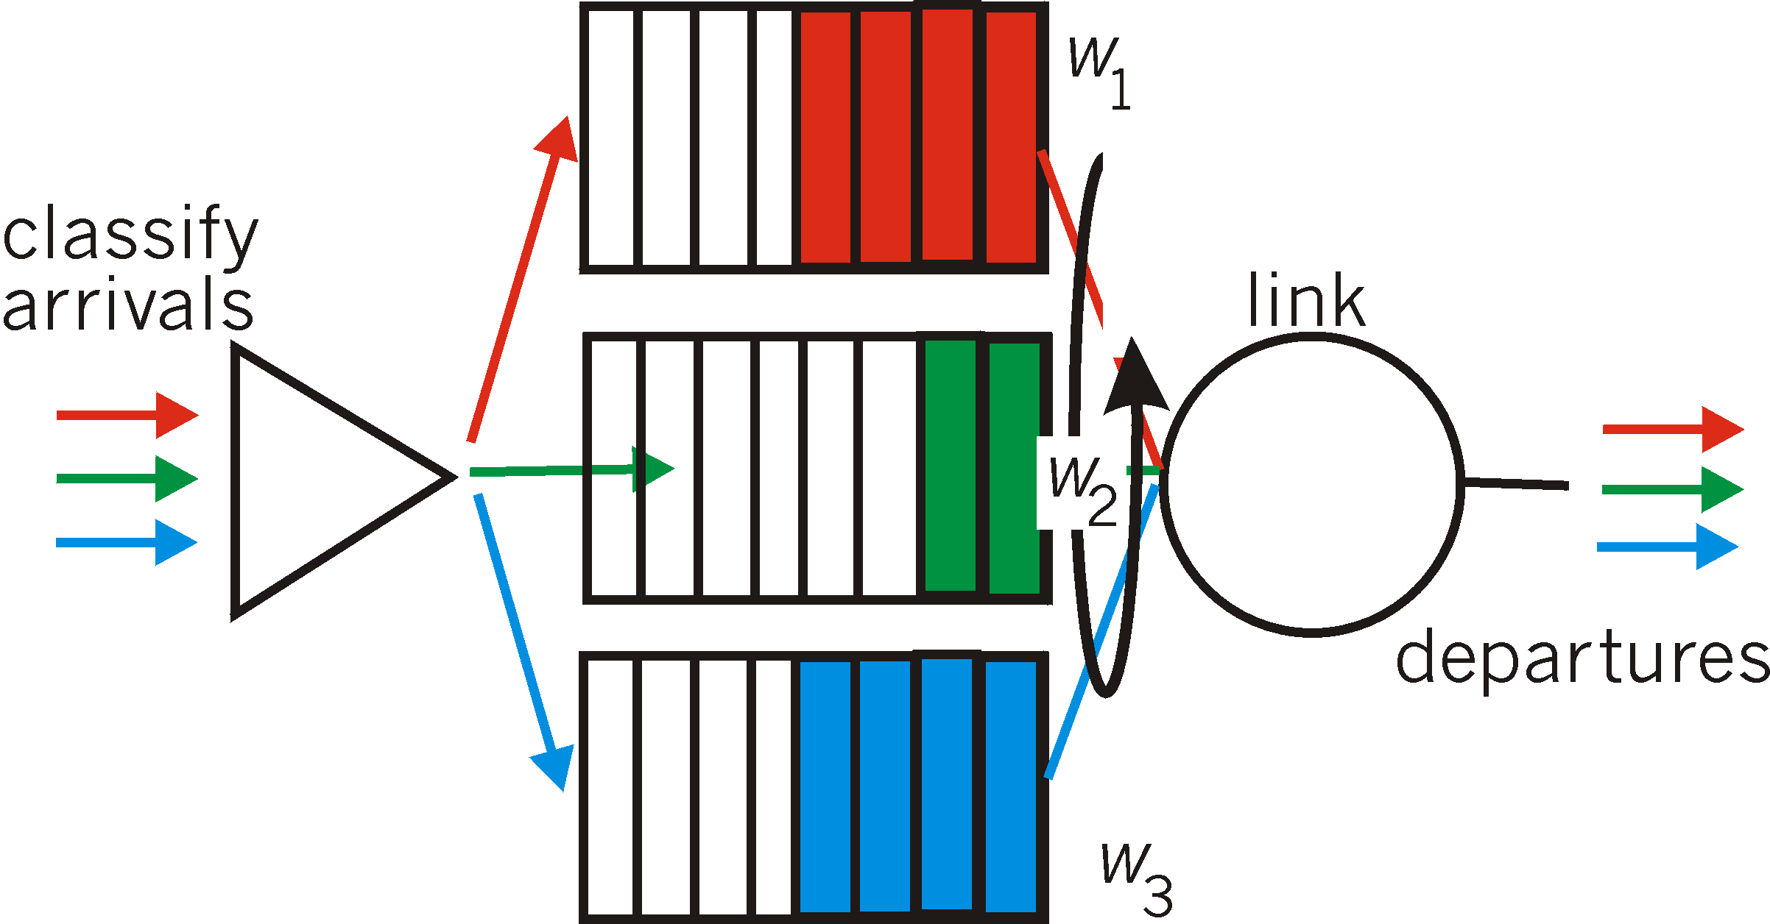
Scheduling policies: still more
Weighted Fair Queuing (WFQ):
weighted Round Robin
each class gets weighted amount of service in each cycle, e.g., each sweep of the queues, red gets 2, green gets 1 and blue gets 3

Slide 17
Chapter 4: outline
4.1 Overview of Network layer
data plane
control plane
4.2 What’s inside a router
4.3 IP: Internet Protocol (v4)
IP Layer services and functions
datagram format
fragmentation
addressing
forwarding
4.4 IPv6
4.5 Internet Control Messaging Protocol (ICMP, ICMPv6)

Slide 18
The IETF network layer
the IETF network layer protocol is called the Internet Protocol (IP)
IP Version 4 (IPv4) is specified in RFC 791 (1981)
IPv6 is new version (initial deployment 2012)
80+% of current Internet traffic is still carried using IPv4
IP henceforth will refer to IPv4 unless IPv6 is explicitly stated
ICMP, IGMP are
Service/helper protocols
related to IP

Slide 19
IP: Waistband of the hourglass
IP is the waistband of the the IETF Internet protocol architecture
only one protocol at the network layer that carries all Internet traffic (control and data) – IP (v4 or v6)
multiple higher-layer protocols
multiple lower-layer protocols
Network Layer: Data Plane 4-19

Slide 20
The Internet network layer
IP is the highest layer protocol implemented in both routers and end devices
Network Layer: Data Plane 4-20

Slide 21
IP Service
delivery service of IP is minimal/simple → robust
IP provide provides an unreliable, connectionless, best effort service (also called: “datagram service”)
unreliable: IP does not make an attempt to recover lost packets
connectionless: each packet (“datagram”) is handled independently. IP is not aware that packets between hosts may be sent in a logical sequence
best effort: IP does not make guarantees on the service (no throughput guarantee, no delay guarantee,…)
consequences - higher layer protocols have to deal with
losses or with duplicate packets
out-of-sequence delivery
Network Layer: Data Plane 4-21

Slide 22
IP Functions
Host:
Router:
routing protocols
path selection
RIP, OSPF, BGP
IP protocol
addressing conventions
datagram format
packet handling conventions
forwarding
table
ICMP protocol
error reporting
router “signaling”

Slide 23
Chapter 4: outline
4.1 Overview of Network layer
data plane
control plane
4.2 What’s inside a router
4.3 IP: Internet Protocol (v4)
IP Layer Services and Functions
datagram format
fragmentation
addressing
forwarding
4.4 IPv6
4.5 Internet Control Messaging Protocol (ICMP, ICMPv6)

Slide 24
IP datagram format
IP protocol version number (4bits)
32 bits
total datagram
length 2¹⁶ (bytes)
header length (4bits)
# of rows of 32bits
(default -no options- 5 rows)
head.
len
type of
service
ver
length
fragment
offset
Fields/bits for
fragmentation/
reassembly
ToS:“type” of service
data needs (8bits)
16-bit identifier
flgs
time to
live
upper
layer
header
checksum
max number
remaining hops (8bits)
(decremented at
each router)
32 bit source IP address
CRC check for
header only
32 bit destination IP address
upper layer protocol
to deliver payload to,
e.g., TCP (6), UDP(17)
options (if any)
e.g. timestamp,
record route
taken, specify
list of routers
to visit (max 40
bytes)
data
(variable length,
typically a TCP
or UDP segment)
Source Address (32bits)
Destination Address (32bits)

Slide 25
Maximum Transmission Unit (MTU)
maximum size of IP datagram is 2¹⁶=65535 bytes, but the data link layer protocol generally imposes a limit that is much smaller
for example:
Ethernet frames have a maximum payload of 1500 bytes→
IP datagrams encapsulated in Ethernet frame cannot be longer than 1500 bytes
the limit on the maximum IP datagram size, imposed by the data link protocol is called the maximum transmission unit (MTU)
examples of MTU sizes for different link protocols:
Ethernet: 1500 SONET: 4470
IEEE 802.3: 1492 MPLS: 1488
Network Layer: Data Plane 4-25

Slide 26

Dilemma – Many Different Links
Internet consists of many different types of links interconnecting all devices
different link types have different link protocols → different MTUs
how does IP know what size to choose for its payload to fit into MTU on every link?
IP also gets segment from transport layer, no control over segment size
Fragmentation

Slide 27
Chapter 4: outline
4.1 Overview of Network layer
data plane
control plane
4.2 What’s inside a router
4.3 IP: Internet Protocol (v4)
IP Layer Services and Functions
datagram format
fragmentation
addressing
Forwarding
4.4 IPv6
4.5 Internet Control Messaging Protocol (ICMP, ICMPv6)

Slide 28

IP fragmentation, reassembly
IP’s MTU mismatch solution
divide (“fragment”) datagram to fit the link MTU
one datagram becomes several datagrams
datagram reassembled at final destination by IP
IP header bits used to identify, order fragments
…
fragmentation:
in: one large datagram
out: 3 smaller datagrams
reassembly
…

Slide 29
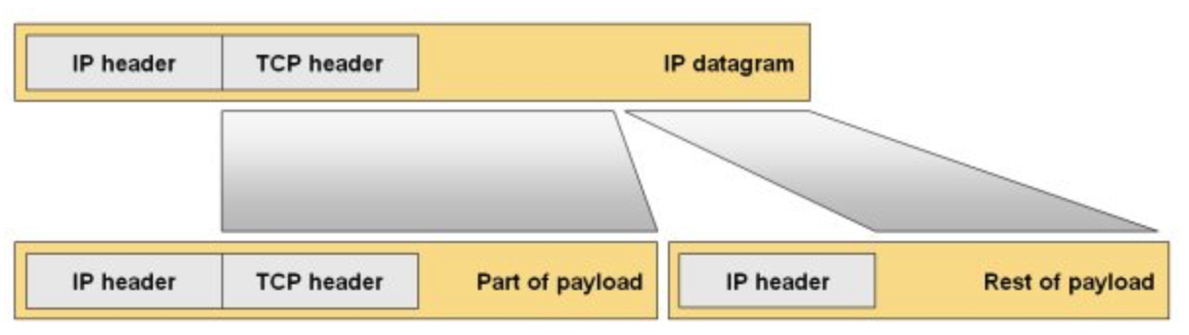
Illustration of Fragmentation
Payload
Note that the next layer header, e.g., Transport layer such as TCP or UDP,
is only in the first fragment.
The second and consecutive fragments only carry application data.

Slide 30
Where is fragmentation done?
fragmentation is done by the IP layer on a host or router at an interface that has an MTU that is smaller than the presented datagram size
fragments of the same datagram can be fragmented several times by routers on the path (S-D) when they encounter smaller MTUs
reassembly of original datagram is only done at destination device IP layer
Network Layer: Data Plane 4-30

Slide 31
Fragmentation impact on IP header
fragmentation affects the IP header (and of course the payload size
Network Layer: Data Plane 4-31

Slide 32
Header Manipulation
Identification when a datagram is fragmented, the identification is the same in all fragments
Flags DF bit is set: “=1” datagram cannot be fragmented and must be discarded if MTU is too small to carry it
MF bit set: “more” “bit = 1” - this datagram is a fragment and an additional fragment follows this one
“bit = 0 – last fragment of original datagram, no more fragments after this one
Fragment offset byte offset of the payload of the fragment in the original datagram (i.e., byte number of the first byte of the fragment payload wrt to original datagram position
Total length total length of the fragment

Slide 33
Datagram to Fragments
Byte number in original frame
byteZ
byte# Y+1
byte# Y
byte# X+1
byte #X
byte1
H
Fragment 1
H1
byte1
offset = 0
Fragment 2
H2
byte1 is byteX+1
offset = X/8
Why divisible by 8?
Fragment 3
H3
The max IP datagram
length is 2¹⁶
The fragment offset
field is 2¹³, it is <2¹⁶
To ref. every byte we need to
divide the payload by a numeral
that will enable offset to
reference it 2¹⁶/2¹³ = 2³ =8
byte1 is byteY+1
offset = Y/8
Fragment Length <
MTU size
Last byte in fragment
Frame
First byte in fragment
T
MTU
H
Fragment Payload = (last byte# – first byte# +1) and the length is divisible by 8
e.g., X=16, 16 – 1 = 15, +1 = 16/8 = 2

Slide 34
IP fragmentation – multiple segments
example:
4000 byte datagram = 20 + 3980
MTU = 1500 bytes
data = 1500-20 (IP header) = 1480bytes
3 fragments: 1480+1480+1020 = 3980
length
=4000
ID
=x
fragflag
=0, =0
offset
=0
last byte
byte #z
one large datagram becomes
several smaller datagrams
1stbyte
byte #1
last byte
byte #x
1480 +20 bytes in data field
length
=1500
ID
=x
fragflag
=0, =1
offset
=0
1stbyte
byte #x+1
length
=1500
ID
=x
fragflag
=0, =1
offset
=185
offset =1480/8=185
last byte
byte #Y
length
=1040
ID
=x
fragflag
=0,=0
offset
=370
offset =2x1480/8=370
last byte
byte #z
1stbyte
byte #y+1

Slide 35
Example of fragmentation
A datagram with size 2400 bytes must be fragmented to fit in an MTU of size 1000 bytes (IP header is 20bytes)
First Fragment:
MTU = 1000
Datagram = 2400 = 20 header + 2380 payload
MTU can carry 1000 – 20 (Header) = 980 data bytes
Fragments have to be multiple of 8 in size (2¹³).
So 980/8=122R4
Therefore carried payload will be 980-4=976 bytes
The first fragment will be 20 (Header) + 976 data = 996 in length.
Fragment offset will be 0 bytes.
Data remaining to be transmitted = 2380 – 976.
Offset of next datagram will be 976/8 = 122
Second Fragment:
Data remaining to be carried: 2380 – 976 = 1404 > 980 --> 976
The second fragment will be 20 (Header) + 976 data = 996 in length.
Fragment offset will be 122 bytes (size of 1st fragment payload).
Offset of next datagram will be 122 + 976/8 = 244
Third Fragment:
Data remaining to be transmitted = 2380 – 976 – 976 = 428
The 3rd fragment will be 20 (Header) + 428 data = 448 in length.
Fragment offset will be 244 bytes (size of 1st + 2nd fragment payloads).
Network Layer: Data Plane 4-35

Slide 36
Chapter 4: outline
4.1 Overview of Network layer
data plane
control plane
4.2 What’s inside a router
4.3 IP: Internet Protocol (v4)
IP Layer Services and Functions
datagram format
fragmentation
addressing
forwarding
4.4 IPv6
4.5 Internet Control Messaging Protocol (ICMP, ICMPv6)

Slide 37
What is an Internet address?
an Internet address is usually referred to as the IP (Internet Procotol) address - henceforth we will refer to it as an IP address
an IP address is a unique global address for a network device interface card
an IP address uniquely identifies the network that a device/host is attached to via an interface card
a device can have multiple network interface cards, each will have an IP address identifying the network it is connected to
Notes:
IP aliasing is associating more than one IP address to a network interface. With this, one node on a network
can have multiple connections to a network, each serving a different purpose.
IP aliasing can be used to provide multiple network addresses on a single physical interface.
This demonstrates using IP version 4 addresses only. One reason for using this could be to make a
computer look as though it is multiple computers, so for example you could have one server that is acting
as both a gateway (router) and a DHCP server and DNS using three different IP addresses, perhaps with
a future plan to use a hardware router and to move the functionality to separate DNS and DHCP servers.
Or indeed the opposite you could decide to replace the three different hardware devices with a single server
to reduce the administration overhead. In this case you can have three different addresses which are all on
the same computer without having to install many physical network interfaces. Another reason is that you
want to have the computer on two different logical network subnets whilst using a single physical interface.
For a router, you can have two subnets on one interface:
Router(config-if)# ip address ip-address mask secondary
Why?
There might not be enough host addresses for a particular network segment. For example, suppose your subnetting
allows up to 254 hosts per logical subnet, but on one physical subnet you must have 300 host addresses.
Using secondary IP addresses on the routers or access servers allows you to have two logical subnets using one physical subnet.
Note If any router on a network segment uses a secondary address, all other routers on that same segment must also use a
secondary address from the same network or subnet.
VLANS now used to solve a lot of these problems.

Slide 38
Internet Addressing: Specifics
IP address: 32-bit identifier for host, router associated with a network interface
interface: connection between host/router and physical link
router’s typically have multiple interfaces
each interface creates a distinct/separate network
hosts typically have one or two interfaces (e.g., wired Ethernet, wireless 802.11)
interfaces may or may not be on the same network
an IP address is associated with each interface
223.1.1.1
223.1.2.1
223.1.1.2
223.1.1.4
223.1.2.9
223.1.1.3
223.1.3.27
223.1.2.2
223.1.3.1
223.1.3.2
148.5.29.2

Slide 39
Addresses and Interface Cards
in a host
if the interface cards are attached to the same network (e.g., for redundancy) they will all identify the same network but will differ in some (least important) bits in the address (sometimes referred to as “host bits”)
an interface can have multiple IP addresses assigned to it – IP aliasing
in a router
a router can have two networks on one interface – unusual (secondary address)
BUT
a router cannot have two interfaces on same network
Notes:
IP aliasing is associating more than one IP address to a network interface. With this, one node on a network
can have multiple connections to a network, each serving a different purpose.
IP aliasing can be used to provide multiple network addresses on a single physical interface.
One reason for using this could be to make a
computer look as though it is multiple computers, so for example you could have one server that is acting
as both a gateway (router) and a DHCP server and DNS using three different IP addresses, perhaps with
a future plan to use a hardware router and to move the functionality to separate DNS and DHCP servers.
Or indeed the opposite you could decide to replace the three different hardware devices with a single server
to reduce the administration overhead. In this case you can have three different addresses which are all on
the same computer without having to install many physical network interfaces. Another reason is that you
want to have the computer on two different logical network subnets whilst using a single physical interface.
For a router, you can have two subnets on one interface:
Router(config-if)# ip address ip-address mask secondary
Why?
There might not be enough host addresses for a particular network segment. For example, suppose your subnetting
allows up to 254 hosts per logical subnet, but on one physical subnet you must have 300 host addresses.
Using secondary IP addresses on the routers or access servers allows you to have two logical subnets using one physical subnet.
Note If any router on a network segment uses a secondary address, all other routers on that same segment must also use a
secondary address from the same network or subnet.
VLANS now used to solve a lot of these problems.

Slide 40
Network number and host number
an IP address:
is a 32 bit long identifier – 4bytes
encodes a network part referred to as network number and a device part referred to as host number
the network number is assigned by a global organization
the host number is assigned locally in each network
human analogy:
network number → ``street name, city, state, country’’
host number → house number
if the interfaces are connected to the same network (i.,e., on the same street), they will only have a different host number (i.e., house number)
if they are connected to different networks, the network number (i.e., street name) (and possibly host number) will be different.
the size (i.e., no. of bits) of the network number is flexible
the size is indicated by a “network mask” and is called, or referred to as, the network prefix (more on that later)
network number
host number

Slide 41
IP Dotted Decimal Notation
IP addresses are written in a dotted decimal format
each byte is identified by a decimal number in the range [0….255] – 2⁸
Example:
10000000
10001111
10001001
10010000
1st Byte
= 128
2nd Byte
= 143
3rd Byte
= 137
4th Byte
= 144
128.143.137.144

Slide 42
Network prefixes and network masks
the network number is identified by a network mask
a network mask consists of contiguous “1’s” for the network number part and contiguous “0’s” for the host number
e.g., an IP address 143.12.10.1 has the network mask:
11111111.11111111.00000000.00000000 -> 255.255.0.0
Q: what is the network number for IP address 143.12.10.1?
A: if you AND the IP address and the network mask you get the network number.
Here 143.12.10.1 AND 255.255.0.0 -> 143.12.0.0
to simplify IP address notation we use the prefix notation:
143.12.10.1/x
/x denotes the number of contiguous “1’s” in the network mask
for our example 255.255.0.0 -> x=16
an IP address is generally given as: 143.12.10.1/16
a host number of “0” refers to the network ID – 143.12.0.0
a host number of all “1” refers to network broadcast address - 143.12.255.255 – all hosts react to the all “1” address

Slide 43
Networks, Devices and IP Addresses
IP address – 32 bits:
network number - high order bits – assigned globally
host number - low order bits – assigned locally
what comprises a network ?
device addresses with same network number
what does it mean?
devices on same network can physically reach each other without help of a router (they can directly ARP each other)
a router is required to send data from one network to another
Net 223.1.0.0
Net 223.1.1.0
Net 223.1.2.0
223.1.1.1
223.1.2.1
223.1.1.2
Router
223.1.1.4
223.1.2.9
223.1.1.3
223.1.3.27
223.1.2.2
Net 223.1.3.0
223.1.3.1
223.1.3.2
3 interconnected networks

Slide 44
How many distinct networks?
223.1.1.2
223.1.1.1
223.1.1.4
223.1.1.3
223.1.9.2
223.1.7.2
223.1.9.1
223.1.7.1
223.1.8.1
223.1.8.2
223.1.2.6
223.1.3.27
223.1.2.1
223.1.2.2
223.1.3.1
223.1.3.2

Slide 45
Network addresses
Q: how does an organization get a block of addresses (network number/ID)?
A: ICANN: Internet Corporation for Assigned
Names and Numbers http://www.icann.org/
allocates address blocks (cost based on network size defined by number of hosts network can support, i.e., “# of host bits”
manages DNS (Domain Name Servers that map Internet names to IP addresses)
assigns domain names, resolves disputes

Slide 46
Addressing in a large organization
usually an organization applies for one “network number” and pays for the size of the host space (i.e., # of host bits)
organizations have multiple departments
and departments want to manage their own networks (floor/bldg/function)
allocate a network number for each department? costly!
solution: introduce a hierarchy to the IP addressing structure only visible within the organization
Institutional Network
128.143.0.0
Engineering
School
Medical
School
Library
Subnetting

Slide 47
Basic Idea of Subnetting
cannot touch the network number – assigned globally
host number assigned locally
split the host number portion of an IP address into a
subnet number and a (smaller) host number
result is a 3-layer hierarchy
network number
host number
network number
subnet number
host number
extended network number
subnets can be freely assigned within the organization
internally, subnets are treated as separate networks
subnet structure is not visible outside the organization

Slide 48
Subnetting & extended mask/prefix
subnetting is done by allocating some of the leading bits of the host number to indicate a subnet number
with subnetting, the network number and the subnet number make up an extended network number
the extended number can be expressed in terms of a subnet mask (subnet prefix)
in our example 143.12.10.1/16, we will use the first byte of the host number (the third byte of the IP address) to denote the subnet number
so subnet mask = 16+8=24
255.255.255.0 is the subnet mask of the subnet
143.12.10.1/24 is the IP address of the host with new prefix = 24
143.12.10.0/24 is the subnet address the host is attached to
note that: 143.12.0.0/16 is the still the network address (or ID) (network prefix /16) of the organization and used to by Internet to route traffic to it
that network now has a subnet layer that is identified by 3rd byte NOT visible to outside world, only used internally.
network number - ID
(16)
subnet number
(8)
host number
(8)

Slide 49
Subnets
223.1.0.0
223.1.1.0/24
one large network:
223.1.0.0/16
comprised of 3 subnets interconnected via a router
each isolated network is called a subnet
223.1.1.0/24
223.1.2.0/24
223.1.3.0/24
223.1.2.0/24
223.1.1.1
223.1.2.1
223.1.1.2
223.1.1.4
223.1.2.9
223.1.1.3
223.1.3.27
subnet
223.1.2.2
223.1.3.1
223.1.3.2
223.1.3.0/24
subnet mask: /24

Slide 50
Advantages of Subnetting
with subnetting, IP addresses use a 3-layer hierarchy:
network
subnet
host
improves efficiency of IP addresses by not consuming an entire address space for each physical network
reduces router complexity.
since external routers do not know about subnetting, the complexity of routing tables at external routers is reduced
note: length of the subnet mask need not be identical for all subnetworks within a campus network

Slide 51
Examples of Prefix Addressing
148.187.97.156/x = 10010100.10111011.01100001.10011100/x
X = 8 -> subnet mask? 11111111.0.0.0 -> 255.0.0.0
Netword ID? Subnet mask AND IP Address
11111111.00000000.00000000.00000000
AND
10010100.10111011.01100001.10011100
Network ID: 148.0.0.0
X = 12 -> subnet mask? 11111111.11110000.0.0 -> 255.192.0.0
Netword ID? Subnet mask AND IP Address
11111111.11110000.00000000.00000000
AND
10010100.10111011.01100001.10011100
Network ID: 148.176.0.0
X = 22 -> subnet mask? 11111111.11111111.11111100.0 -> 255.255.252.0
Netword ID? Subnet mask AND IP Address
11111111.11111111.11111100.00000000
AND
10010100.10111011.01100001.10011100
Network ID: 148.187.96.0

Slide 52
An example of subnetting
Given: a campus network address of 125.36.0.0/16
create subnets that can accommodate maximum of 500 hosts each (all 1’s and all 0s cannot be used for host bits, reserved – so max host# +2 is required host space)
Steps to create subnets and host number space:
125.36 → cannot be touched – assigned
rightmost 32-16 =16 bits of this network address are ‘host’ bits
0.0 → (host bits) –> 8 + 8 = 16 bits
500+2 hosts require “x” bits for host addressing
2^{x} > 502, what is x? 2⁸ = 256 < 502 < 2⁹ = 512 → x=9
we need 9 bits to accommodate the required number of hosts for this network
what remains can be used for subnetting:
subnet address space = 16 – bits required for hosts = 16 - x
x = 9, therefore # of bits available for subnets = 16 – 9 = 7
7 bits left for subnetting → 2⁷=128 subnets with 512 hosts/subnet
subnet addresses: {0,1, 2, 3, 4….127}

Slide 53
An example of subnetting
Given: a campus network prefix of 125.36.0.0/16
create 5 subnets to accommodate a minimum of 250 hosts each
Network ID:125.36 → cannot be touched - assigned
0.0 → (subnet + host bits) –> 8 + 8 = 16 bits
need only 5 subnets: 2²=4 < 5 –> not enough, 2³=8 > 5 → 3 bits
subnet addresses: {0,1, 2, 3, 4, 5, 6, 7}
host address space = 16 – 3 subnet bits =13bits -> 2¹³ >250
125.36.0.0 campus network - possible subnets
125.36.xxxxxxxx.xxxxxxxx → xxx -> 2³ = {0,1,2,3,4,5,6,7}
Sample subnets with subnet prefix 16+3 = 19:
125.36.00100000.00000000 → 125.36.32.0/19
125.36.01000000.00000000 → 125.36.64.0/19
125.36.01100000.00000000 → 125.36.96.0/19
125.36.10000000.00000000 → 125.36.128.0/19
125.36.10100000.00000000 → 125.36.160.0/19

Slide 54
Another example
Given: a campus network ID of 125.36.0.0/18
create 10 subnets for this campus network
125.36.00 (=18) → cannot be touched - assigned
000000.0 → (subnet + host bits) –> 6 + 8 = 14 bits
rightmost 14 bits of this campus IP address are “subnet + host” bits
need 10 subnets → 2³ = 8 < 10, 2⁴ = 16 → 4 bits
subnet addresses: {0,1, 2, ……, 15}
leaves 14 - 4 = 10bits for host addresses -> 2¹⁰ = 1024 addresses
125.36.0.0/18 campus network, possible subnets:
xxxxxxxx.xxxxxxxx → xxxx – {0,1,2,3,...15}
example subnet IDs with prefix 18 + 4 = 22:
125.36.00000000.00000000 → 125.36.0.0/22
125.36.00000100.00000000 → 125.36.4.0/22 (3rd byte: 00000100=4)
125.36.00001000.00000000 → 125.36.8.0/22 (3rd byte: 00001000=8)
125.36.00001100.00000000 → 125.36.12.0/22 (3rd byte: 00001100=12)
125.36.00100100.00000000 → 125.36.36.0/22
125.36.00101000.00000000 -> 125.36.40.0/22

Slide 55
Another example
Given previous example, 2 subnets are subnetted further into 2 subnets, each to accommodate max. of 500 hosts each.
assume we used subnet IDs {0,1,…9} → {0000, 0001, 0010,…. 1001}
use subnets 0000 and 0001 to further subnet in two subnets
125.36.00000000.00000000 → 125.36.0.0/22
125.36.00000100.00000000 → 125.36.4.0/22
500 hosts --> 2⁹ = 512, we need to allocate 9 bits for host address
125.36.0000000x.xxxxxxxx/22
125.36.0000010x.xxxxxxxx/22
two subnets need 1 bit (0, 1)
125.36.000000?x.xxxxxxxx
125.36.000001?x.xxxxxxxx
subnet ID prefixes for these new subnets will be: 22 + 1 = 23
Subnet IDs will be: subnet numbers now are: 0000xx, 0001xx
00000, 00001 → 0, 2 -> 125.36.00000000.00000000/23, 125.36.00000010.00000000/23
00010, 00011 → 4, 6 -> 125.36.00000100.00000000/23, 125.36.00000110.00000000/23

Slide 56
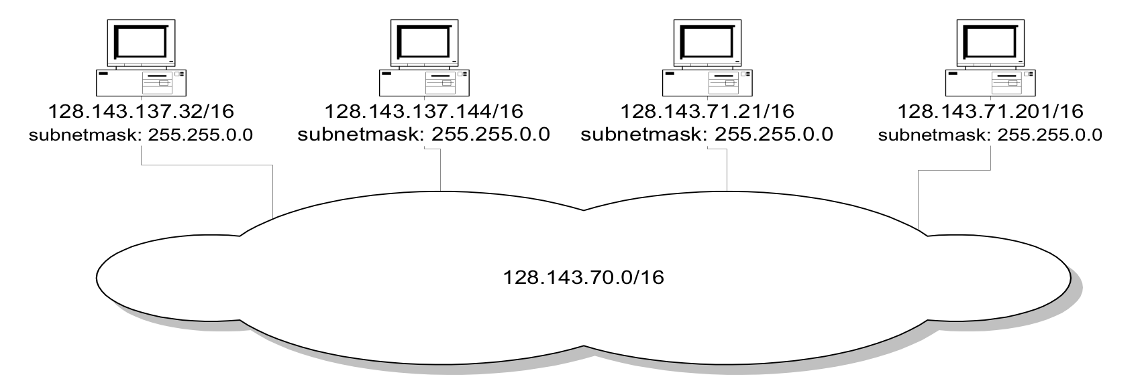
Network without subnets
128.143.0.0/16

Slide 57
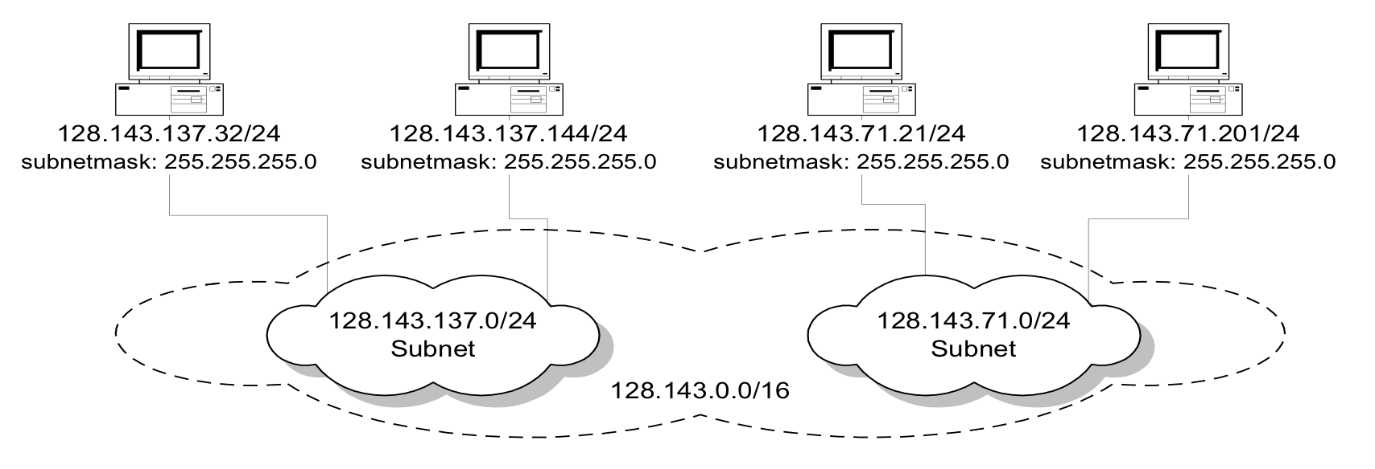
Same network with subnets

Slide 58
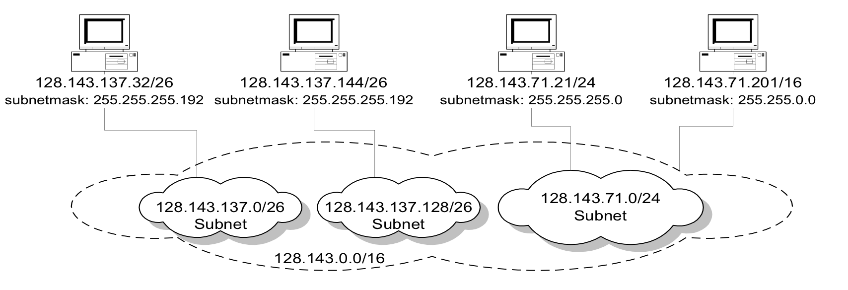
Same network with more subnetmasks
128.143.137.0/24
Subnet

Slide 59
Final subnetting example
an organization with 4 departments has the following IP address space: 10.2.22.0/23. As the systems manager, you are required to create subnets to accommodate the IT needs of 4 departments. The subnets have to support up to 200, 71, 55, and 41 hosts respectively. What are the 4 subnet network numbers?
solution:
10.2.22.0/24 (256 addresses > 200)
10.2.23.0/25 (128 addresses >71)
10.2.23.128/26 (64 addresses > 55)
10.2.23.192/26 (64 addresses > 41)

Slide 60
Subnetting example with different subnet sizes
an organization with 4 departments has the following IP address space: 10.2.22.0/23. As the systems manager, you are required to create subnets to accommodate the IT needs of 4 departments. The subnets have to support up to 200, 71, 55, and 41 hosts respectively. What are the 4 subnet network numbers?
solution:
10.2.22.0/24 (2⁸=256 addresses > 200)
10.2.23.0/25 (2⁷=128 addresses >71)
10.2.23.192/26
10.2.23.192/26 (2⁶=64 addresses > 55)
10.2.23.128/26 (2⁶=64 addresses > 41)
10.2.22.0/23
x.xxxxxxxx
0 or 1 with 2⁸ (256) hosts -> 1st subnet –
x=0 -> 10.2.22.0/24. x=1 for next tier
0 or 1 with 2⁷ (128) hosts -> 2nd subnet -
x=0 -> 10.2.23.128/25. x=1 for next tier
0 or 1 with 2⁶ (64) hosts -> 3rd and 4th subnets
x=1 3rd subnet 10.2.23.192/26
x=0 4th subnet 10.0.22.128/26

Slide 61
Example of a subnetting plan
Internet
Subnet 128.49.2.0/24
Subnet 2
0=00000000
Subnet 128.49.1.0/25
Subnet 4
Router
R
Subnet 128.49.1.128/25
Subnet 5
128=10000000
Subnet 1: 128.49.1.0/24
Subnet 3
Subnet 128.49.3.0/24
2 bytes available for subnetting
IP Network: 128.49.0.0/16

Slide 62
Hierarchical addressing: route aggregation
hierarchical addressing allows efficient advertisement of routing information:
ISP-1's block 11001000 00010111 00010000 00000000 200.23.16.0/20
Organization 0 11001000 00010111 00010000 00000000 200.23.16.0/23
Organization 1 11001000 00010111 00010010 00000000 200.23.18.0/23
Organization 2 11001000 00010111 00010100 00000000 200.23.20.0/23
... ….. …. ….
Organization 7 11001000 00010111 00011110 00000000 200.23.30.0/23
Organization 0
200.23.16.0/23
Organization 1
“Send me anything
with addresses
beginning with
200.23.16.0/20”
200.23.18.0/23
Organization 2
.
200.23.20.0/23
.
ISP-1
.
.
Internet
.
Organization 7
.
200.23.30.0/23
ISP-2

Slide 63
CIDR - Classless InterDomain Routing
builds on the flexible netmask concept
restructure IP address assignments to increase efficiency
hierarchical routing aggregation to minimize route table entries
Key Concept: the length of the network id (prefix) in IP addresses is arbitrary/flexible and is defined by the network hierarchy.
consequence:
routers use the IP address and the length of the prefix for forwarding.
all advertised IP addresses must include a prefix

Slide 64
IP addressing and CIDR
subnet portion of address is of arbitrary length
address format used: a.b.c.d/x, where x is # bits in subnet portion of address
Network/subnet
part
host
part
11001000 00010111 00010000 00000000
200.23.16.0/23

Slide 65
CIDR Example
assume that a site requires an IP network domain that can support 1000 IP host addresses
with CIDR, the network is assigned a continuous block of:
1024 = 2¹⁰ (>1000) addresses
with a 32-10 = 22-bit long prefix

Slide 66
CIDR: prefix value vs. host space
CIDR Block Prefix # of Host Addresses
/27 32 hosts
/26 64 hosts
/25 128 hosts
/24 256 hosts
/23 512 hosts
/22 1,024 hosts
/21 2,048 hosts
/20 4,096 hosts
/19 8,192 hosts
/18 16,384 hosts
/17 32,768 hosts
/16 65,536 hosts
/15 131,072 hosts
/14 262,144 hosts
/13 524,288 hosts

Slide 67
CIDR and Address assignments
Backbone ISPs obtain large blocks of IP address space and then reallocate portions of their address blocks to their customers.
example:
assume that an ISP owns the address block 206.0.64.0/18
206.0.01000000.0/18
32-18 = 14 represents 2³²⁻¹⁸=2¹⁴ IP host addresses
suppose a client requires 800 host addresses
512=2⁹<800<1024=2¹⁰ -> 32-10 = 22
assign a /22 block – 206.0.01????xx.xxxxxxxx/22
e.g., 206.0.010001xx.xxxxxxxx -> 206.0.68.0/22 allocates a block of 1,024 (2¹⁰) IP addresses to client

Slide 68
Example CIDR Address Assignment
Company X :
206.0.68.0/22
ISP K owns:
206.0.64.0/18
204.188.0.0/15
209.88.232.0/21
Internet Backbone
ISP y :
209.88.237.0/24
Organization z1 :
209.88.237.192/26
Organization z2 :
209.88.237.0/26

Slide 69
Example CIDR Address Assignment
Backbone routers do not know anything about Company X, ISP Y, or Organizations Z1, Z2.
Company X :
206.0.68.0/22
ISP K owns:
ISP K sends everything which matches the prefix: 206.0.68.0/22 to Company X,
209.88.237.0/24 to ISP Y
206.0.64.0/18
204.188.0.0/15
209.88.232.0/21
ISP Y sends everything which matches the prefix: 209.88.237.192/26 to Organizations Z1 209.88.237.0/26 to Organizations Z2
Internet Backbone
ISP K does not know about Organizations Z1, Z2.
Backbone sends everything which matches the prefixes 206.0.64.0/18, 204.188.0.0/15, 209.88.232.0/21 to ISP K.
ISP Y :
209.88.237.0/24
Organization Z1 :
209.88.237.192/26
Organization Z2 :
209.88.237.0/26

Slide 70
IP address: how to get one?
Q: How does a router get IP address?
hard coded by system admin
every interface/port is assigned a unique IP address reflecting network assignment
Q: How does a host get IP address?
hard-coded by system admin in a file
Windows: control-panel->network->configuration->tcp/ip->properties
UNIX: /etc/rc.config
DHCP: Dynamic Host Configuration Protocol: dynamically get address from as server
“plug-and-play”
223.1.2.9
223.1.1.4
223.1.1.0
223.1.2.0
223.1.3.2
223.1.3.0

Slide 71
Chapter 4: outline
4.1 Overview of Network layer
data plane
control plane
4.2 What’s inside a router
4.3 IP: Internet Protocol (v4)
IP Layer Services and Functions
datagram format
fragmentation
addressing
forwarding
4.4 IPv6
4.5 Internet Control Messaging Protocol (ICMP, ICMPv6)

Slide 72
IP Forwarding
in a network: process of getting from source to destination – moving forward hop-by-hop
usually requires a routing function that determines the hop-by-hop sequence to follow and referred to as routing
in a router: move packets from router’s input to appropriate router output
uses the routing information that determines the next hop for a destination and from that determines the interface leading to that next hop to forward the datagram

Slide 73
Hop-by-Hop Delivery of a datagram
view at the IP layer:
an IP network is a logical entity with a network (subnet) number
we represent an IP network as a “cloud”
IP delivery service is hop-by-hop across clouds of networks/subnets
IP

Slide 74
Under the Hood
view at the data link layer layer:
the clouds consist of collection of LANs, switched LANs, point-to-point links, that are connected by routers
IP

Slide 75
Destination Based Forwarding
forward datagram based only on destination IP address
look up output port using forwarding table
forwarding table maps IP destinations to:
outgoing interfaces – direct connection
next hop router – intermediate hop

Slide 76
Tenets of end-to-end delivery of datagrams
The following conditions must hold so that an IP datagram can be successfully delivered
The network prefix of an IP destination address must correspond to a unique network interface – i.e., a data link layer network (LAN or point-to-point link or switched network).
Routers and hosts that have a common network prefix must be able to exchange IP datagrams using a data link protocol (e.g., Ethernet, PPP).
An IP network is formed when a data link layer network is connected to at least one other data link layer network via a router. Each router interface is an IP network.

Slide 77
Processing of an IP datagram in IP
processing of IP datagrams is very similar on an IP router and a host
main difference: “IP forwarding” is enabled on router and disabled on host
IP forwarding enabled → if a datagram is received, but it is not for the local system, the datagram will be sent to a different system
IP forwarding disabled → if a datagram is received, but it is not for the local system, the datagram will be discarded

Slide 78
Processing of IP datagram at a Host
Receive an IP datagram
IP header validation (error checking). Fails, drop datagram.
Datagram addressed to this host? No, ignore (i.e, drop).
If error in a header field (not caught by checksum or error by source), e.g., non existing upper layer, non existing port, etc., send ICMP packet reporting error
If no errors, pass payload to identified next layer.
ICMP – IP control protocol used for reporting errors to datagram delivery to source.
More later.

Slide 79
Processing of IP datagram at a router
Receive an IP datagram
IP header validation. Fails, drop datagram.
Process options in IP header
Datagram addressed to this router? No
Forwarding table lookup for address – obtain outgoing interface
Decrement TTL
Perform fragmentation (if necessary)
Calculate checksum
Forward to link or next hop
OR
Send ICMP packet to source (if error in steps 4., 5. or 6.)

Slide 80
Forwarding tables
Each router and each host maintains a forwarding table which tells the router how to process an outgoing packet
Main columns:
Destination address: where is the IP datagram going to?
Next hop or interface: how to send the IP datagram?
Forwarding tables are setup so that a datagram gets closer to its destination with every hop
Forwarding table of a host or router
IP datagrams can be directly delivered (“direct” via an interface) or are sent to a next hop router (R1,R2,R4).
Entry in table will give interface number (e.g., eth0) or IP address of next hop router (e.g., R2=10.2.1.5)
Destination | Next Hop
20.2.1.0/28 10.1.0.0/24 10.1.2.0/24 10.2.1.0/24 10.3.1.0/24 20.1.0.0/16 | direct R2 R4 direct direct R1

Slide 81

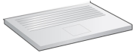

Example of Next Hops
10.0.96.0/24
10.0.96.1/19
eth0
Forwarding Table of
Router
ser1
10.0.192.11/18
10.0.192.1/18
R2
eth1
10.0.192.0/18
ser1
12.0.160.1/19
eth1
Destination
Next Hop
20.160.0.1/14
Host
Network
Network
Network
Network
Default
10.0.160.3/32
10.0.96.0/24
10.0.160.0/19
10.0.192.0/18
20.160.0.0/14
0.0.0.0
Direct - eth1
Direct - eth0
Direct - eth1
Direct - ser1
R2-10.0.192.11
R2-10.0.192.11
10.0.160.0/19
20.160.0.0/14
10.0.160.3/19

Slide 82
Types of forwarding table entries
Network route (prefix 1-31)
Destination addresses is a network address (e.g., 10.0.2.0/24)
Most entries are network routes
Host route (prefix 32)
Destination address is an interface address (e.g., 10.0.1.2/32)
Used to specify a separate route for certain hosts
Default route (prefix 0)
Used when no network or host route matches
The router that is listed as the next hop of the default route is the default gateway (for Cisco: “gateway of last resort)
Loopback address (prefix 8)
Routing table for the loopback address (127.0.0.1)
The next hop lists the loopback (lo0) interface as outgoing interface

Slide 83
Forwarding table lookup
Destination address | Next hop
network prefix (/1-31) or host IP address (/32) or loopback address (/8) or default route (/0) | IP address of next hop router* or Name of a network interface
When a router or host needs to transmit an IP datagram, it performs a routing table lookup
Routing table lookup: Use the IP destination address as a key to search the routing table.
Result of the lookup is the IP address of a next hop router, or the name of a network interface
* Note: A router has many IP addresses. The IP address in the routing table refers to the address of the network interface of next hop router on the same directly connected network.

Slide 84
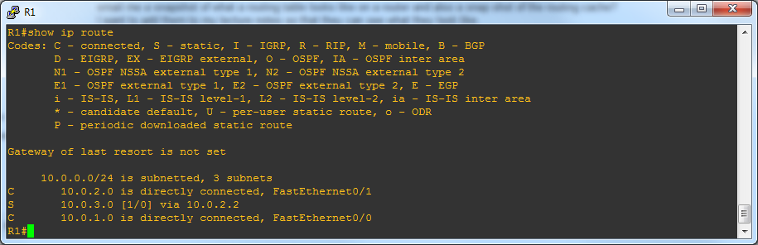
Typical Forwarding Table at:
Host
Destination Gateway Genmask Flags Iface
10.0.96.100 10.0.160.1 255.255.255.255 UGH eth0
10.0.32.0 10.0.192.2 255.255.224.0 UG eth1
10.0.96.0 10.0.160.1 255.255.224.0 UG eth0
10.0.64.0 10.0.192.1 255.255.224.0 UG eth1
10.0.160.0 *(direct) 255.255.224.0 U eth0
10.0.192.0 *(direct) 255.255.224.0 U eth1
127.0.0.1 * 255.0.0.0 U lo
0.0.0.0(default) 10.0.160.2 0.0.0.0 UG eth0
Router
Prefix
/32
/19
/19
/19
/19
/19
/8
/0
Flags:
U – Up
G – Gateway
H - Host

Slide 85
How Does a Router use the Forwarding table?
When a router receives a datagram, after validating the header, and processing the options, it consults the forwarding table to decide which output port it needs to forward the datagram too.
The IP destination address is used to determine the appropriate output port by matching it to a table entry.
Starting from the first entry in the forwarding table and working one’s way down to the default entry, the network prefix of the destination column for each entry is applied to the IP destination address.
AND the netmask of network prefix and apply to destination IP address
if resulting network number that matches the network number in the table you have a match.
If the result is equal in value to the destination entry then we have found a match and the value in the Next Hop column is the desired output.

Slide 86
Example to illustrate Forwarding Function
For destination IP address: 128.143.71.21
1st entry has prefix /32. That means a perfect match on all bits (Host address). 128.143.71.21/32 => 128.143.73.55/32? No it does NOT match.
2nd entry has prefix /24. That means that 128.143.71.21/24 => 128.143.82.0/24? NO it does NOT match. 128.143.71.21/24 => 128.143.71.0/24, and that is not 128.143.82.0.
3rd entry has prefix /20. 128.143.71.21/20 => 128.143.64.0? YES, a prefix of /20 on the destination IP address results in 128.143.64.0/20. That is a match.
Next hop column says that datagram needs to be forwarded to router R4, and R4 will represent the IP address of that router on the connecting link (e.g. 128.143.64.2.
128.143.71.21
Router Forwarding
Table
Datagram
128.143.71.21
128.143.64.1
128.143.64.2
R4
?

Slide 87
Using Prefixes to Find a Match
1st entry prefix /32: 128.143.71.21/32 => 128.143.73.55??
128.143.71.21 with prefix 32, means AND of 255.255.255.255 (32 “1”s)
128.143.71.21 AND 255.255.255.255 = 128.143.71.21
NOT equal to 1st 128.143.73.55
2nd entry prefix /24: 128.143.71.21/24 => 128.143.82.0??
128.143.71.21 with prefix 24, means AND of 255.255.255.0 (24 “1”s)
128.143.71.21 AND 255.255.255.0 = 128.143.71.0
NOT equal to 2nd 128.143.82.0
3rd entry prefix /20: 128.143.71.21/20 => 128.143.64.0??
128.143.71.21 with prefix 20, means AND of 255.255.240.0 (20 “1”s)
128.143.71.21 AND 255.255.240 = 128.143.64.0
YES equal to 3rd entry 128.143.64.0
Note if no match till “default” (prefix /0) means NO match on any bits.

Slide 88
Prefix Matching Process
128.143.71.21/32 => 128.143.73.55??
/32 = 255.255.255.255
128.143.71.21 AND 255.255.255.255
128.143.71.21 = 10000000.10001111.01000111.00010101
AND
255.255.255.255 = 11111111.11111111.11111111.11111111
10000000.10001111.01000111.00010101 => 128.143.71.21
BUT table has: 128.143.73.55 = 10000000.10001111.01001001.00101101
Not equal
128.143.71.21/24 => 128.143.82.0??
/24 = 255.255.255.0
128.143.71.21 AND 255.255.255.0
128.143.71.21 = 10000000.10001111.01000111.00010101
AND
255.255.255.0 = 11111111.11111111.11111111.00000000
10000000.10001111.01000111.00000000 => 128.143.71.0
BUT table has 128.143.82.0 = 10000000.10001111.01010010.00000000
Not equal

Slide 89
Prefix Matching Process
128.143.71.21/20 => 128.143.64.0??
/20 = 255.255.240.0
128.143.71.21 AND 255.255.240.0
128.143.71.21 = 10000000.10001111.01000111.00010101
AND
255.255.240.0 = 11111111.11111111.11110000.00000000
10000000.10001111.01000000.00000000 => 128.143.64.0
128.143.64.0 = 10000000.10001111.01000000.00000000
Equal

Slide 90
Longest Prefix Match
128.143.71.21
Longest Prefix Match: Search for the routing table entry that has the longest prefix match with the destination IP address. WHY?
The longer the prefix the closer you are to destination….
Search for a match on all 32 bits
Search for a match for 31 bits
…..
32. Search for a match on 0 bits
Note: you only search on prefixes that are in
the table (here 32, 24, 20….)
Host route → 32-bit prefix match
Default route is represented as 0.0.0.0/0 → 0-bit prefix match
The longest prefix match for 128.143.71.21 is for 20 bits with entry 128.143.64.0/20
Datagram will be sent to R4
Matches but prefix 16 < 20

Slide 91

Forwarding to an interface
20.2.1.0
R4
128.5.2.1
IP Dest:
10.2.1.55
?
10.4.2.0
?
10.4.2.2
136.4.33.2
Datagram
eth0
ser0
10.3.1.0
eth2
?
eth1
?
10.2.1.0
Destination | Next Hop
20.2.1.0/28 10.4.2.0/24 10.1.2.0/24 10.2.1.0/24 10.3.1.0/24 20.1.0.0/16 | eth0 ser0 R4 eth1 eth2 R4
10.2.1.55/28 = 10.2.1.32 = 20.2.1.0
10.2.1.55/24 = 10.2.1.0 = 10.4.2.0
10.2.1.55/24 = 10.2.1.0 = 10.1.2.0
10.2.1.55/24 = 10.2.1.0 = 10.2.1.0

Slide 92
Forwarding to a Router as next hop
10.1.2.0
20.2.1.0
10.1.2.1
R4
128.5.2.1
IP Dest:
10.1.2.65
?
10.4.2.0
?
10.4.2.2
136.4.33.2
Datagram
eth0
ser0
10.3.1.0
eth2
?
eth1
?
10.2.1.0
Destination | Next Hop
20.2.1.0/28 10.4.2.0/24 10.1.2.0/24 10.2.1.0/24 10.3.1.0/24 20.1.0.0/16 | eth0 ser0 R4(10.4.2.2) eth1 eth2 R4
10.1.2.65/28 = 10.1.2.64 = 20.2.1.0
10.1.2.65/24 = 10.1.2.0 = 10.4.2.0
10.1.2.65/24 = 10.1.2.0 = 10.1.2.0
Route to R4 – IP address 10.4.2.2
10.4.2.2/28 = 20.2.1.0
10.4.2.2/24 = 10.4.2.0
92

Slide 93
Constructing a Network Topology from a Host’s Forwarding Table
Destination | Router/ Interface
10.0.96.100/32 | 10.0.160.1 (R1)
10.0.32.0/19 | 10.0.192.2 (R2)
10.0.96.0/19 | 10.0.160.1 (R1)
10.0.64.0/19 | 10.0.192.1 (R3)
10.0.160.0/19 | eth0
10.0.192.0/19 | eth1
127.0.0.0/8 | lo
0.0.0.0 | 10.0.160.2 (R4)
lo: loopback always 127.0.0.0/8
used for testing, never leaves host
10.32.0.0/19
R2
R3
10.0.64.0/24
10.0.192.0/19
All other destinations
eth1
R4
eth0
10.0.160.0/19
R1
10.0.96.0/24
10.0.96.100/24

Slide 94
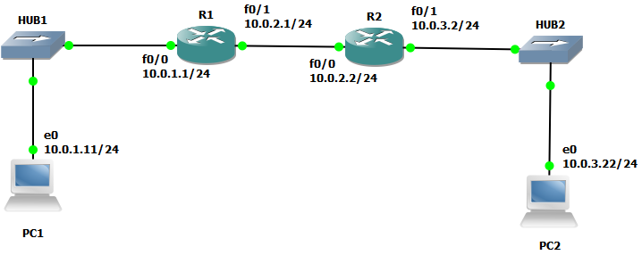
GNS3 Example

Slide 95
Forwarding Table and Routing Cache
every router has a routing table
from routing table a forwarding table is created
once a destination has been looked up in the forwarding table, it is placed in a route cache to speed up future references for this destination address

Slide 96
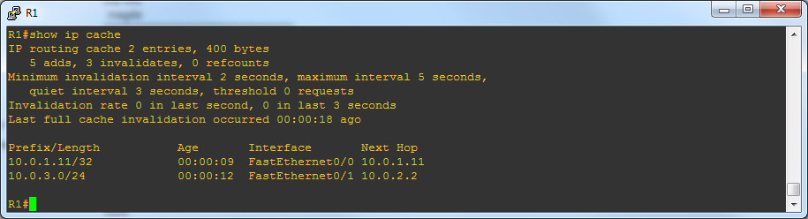
Forwarding Table & Cache on R1
Remote Network
Shows next hop
Then it consults table
how to forward to next
hop 10.0.2.2
-> looks for connecting
interface
Directly connect networks
Shows local interfaces
Why next hop?

Slide 97
Encapsulation, Headers & Addresses
source
message
M
application
transport
network
link
physical
segment
H_{t}
M
H_{t}
datagram
H_{n}
H_{t}
M
H_{l}
H_{n}
H_{t}
T_{l}
frame1
M
H_{n}
H_{t}
M
frame1
H_{l}
H_{n}
H_{t}
T_{l}
H_{x}: header
T_{x}: trailer
M: message
X: t - transport, n - network, l - link
M
network
link
physical
=
router
=
destination
M
application
transport
network
link
physical
H_{n}
H_{t}
M
H_{t}
M
frame2
H_{l}
H_{n}
H_{t}
T_{l}
M
H_{n}
H_{t}
M
H_{l}
H_{n}
H_{t}
T_{l}
frame2
M

Slide 98

Addressing: routing to another LAN
walkthrough: send datagram from A to B via R
focus on addressing – at IP (datagram) and MAC layer (frame)
assume A knows B’s IP address
assume A knows IP address of first hop router, R (routing table)
assume A knows R’s MAC address (ARP)
A
B
R
111.111.111.111
222.222.222.222
74-29-9C-E8-FF-55
49-BD-D2-C7-56-2A
222.222.222.220
1A-23-F9-CD-06-9B
111.111.111.112
111.111.111.110
222.222.222.221
CC-49-DE-D0-AB-7D
E6-E9-00-17-BB-4B
88-B2-2F-54-1A-0F

Slide 99
Addressing: routing to another LAN
A creates IP datagram with IP source A, destination B
A creates link-layer frame with R's MAC address as dest, frame contains A-to-B IP datagram
MAC src: 74-29-9C-E8-FF-55
MAC dest: E6-E9-00-17-BB-4B
IP
Eth
Phy
IP src: 111.111.111.111
IP dest: 222.222.222.222
A
B
R
111.111.111.111
222.222.222.222
74-29-9C-E8-FF-55
49-BD-D2-C7-56-2A
222.222.222.220
1A-23-F9-CD-06-9B
111.111.111.112
111.111.111.110
222.222.222.221
CC-49-DE-D0-AB-7D
E6-E9-00-17-BB-4B
88-B2-2F-54-1A-0F

Slide 100
Addressing: routing to another LAN
frame sent from A to R
frame received at R, datagram extracted, passed up to IP
MAC src: 74-29-9C-E8-FF-55
MAC dest: E6-E9-00-17-BB-4B
IP src: 111.111.111.111
IP dest: 222.222.222.222
IP
Eth
Phy
IP src: 111.111.111.111
IP dest: 222.222.222.222
IP
Eth
Phy
A
B
R
111.111.111.111
222.222.222.222
74-29-9C-E8-FF-55
49-BD-D2-C7-56-2A
222.222.222.220
1A-23-F9-CD-06-9B
111.111.111.112
111.111.111.110
222.222.222.221
CC-49-DE-D0-AB-7D
E6-E9-00-17-BB-4B
88-B2-2F-54-1A-0F

Slide 101
Addressing: routing to another LAN
R forwards datagram with IP source A, destination B
R creates link-layer frame with B's MAC address as dest, frame contains A-to-B IP datagram
MAC src: 1A-23-F9-CD-06-9B
MAC dest: 49-BD-D2-C7-56-2A
IP
Eth
Phy
IP
Eth
Phy
IP src: 111.111.111.111
IP dest: 222.222.222.222
A
B
R
111.111.111.111
222.222.222.222
74-29-9C-E8-FF-55
49-BD-D2-C7-56-2A
222.222.222.220
1A-23-F9-CD-06-9B
111.111.111.112
111.111.111.110
222.222.222.221
CC-49-DE-D0-AB-7D
E6-E9-00-17-BB-4B
88-B2-2F-54-1A-0F

Slide 102
Addressing: routing to another LAN
R forwards datagram with IP source A, destination B
R creates link-layer frame with B's MAC address as dest, frame contains A-to-B IP datagram
MAC src: 1A-23-F9-CD-06-9B
MAC dest: 49-BD-D2-C7-56-2A
IP
Eth
Phy
IP
Eth
Phy
IP src: 111.111.111.111
IP dest: 222.222.222.222
A
B
R
111.111.111.111
222.222.222.222
74-29-9C-E8-FF-55
49-BD-D2-C7-56-2A
222.222.222.220
1A-23-F9-CD-06-9B
111.111.111.112
111.111.111.110
222.222.222.221
CC-49-DE-D0-AB-7D
E6-E9-00-17-BB-4B
88-B2-2F-54-1A-0F

Slide 103
Addressing: routing to another LAN
R forwards datagram with IP source A, destination B
R creates link-layer frame with B's MAC address as dest, frame contains A-to-B IP datagram
MAC src: 1A-23-F9-CD-06-9B
MAC dest: 49-BD-D2-C7-56-2A
IP src: 111.111.111.111
IP dest: 222.222.222.222
IP
Eth
Phy
A
B
R
111.111.111.111
222.222.222.222
74-29-9C-E8-FF-55
49-BD-D2-C7-56-2A
222.222.222.220
1A-23-F9-CD-06-9B
111.111.111.112
111.111.111.110
222.222.222.221
CC-49-DE-D0-AB-7D
E6-E9-00-17-BB-4B
88-B2-2F-54-1A-0F

Slide 104


Local/Adjacent and Remote devices
All devices are on same “network” (137.196.7) can find and reach each other via MAC address
Devices on different “network” (137.196.49) can only be reached via a router using network address of remote host to find router IP address (next hop)
137.196.7.78
137.196.7.1
bd-c4-11-af-55-03
137.196.49.1
1a-2f-bb-76-09-ad
f4-18-13-df-57-93
137.196.7.23
LAN
137.196.7.14
137.196.49.51
LAN
71-65-f7-2b-08-53
58-23-d7-fa-20-b0
18-a4-d7-fa-20-c0
0c-c4-11-6f-e3-98
137.196.49.3
137.196.7.88

Slide 105
Remote devices
Devices on different “networks” (137.196.49) can only be reached via a router.
That means that the host cannot ARP for the remote host, uses a next hop router.
Host 137.196.7.88 will ARP for ROUTER 137.196.7.1 interface MAC address
Then ROUTER will ARP for Host 137.196.49.3 interface MAC address
137.196.7.78
137.196.7.1
bd-c4-11-af-55-03
137.196.49.1
1a-2f-bb-76-09-ad
f4-18-13-df-57-93
137.196.7.23
ROUTER
LAN
137.196.7.14
137.196.49.51
LAN
71-65-f7-2b-08-53
58-23-d7-fa-20-b0
18-a4-d7-fa-20-c0
0c-c4-11-6f-e3-98
137.196.49.3
137.196.7.88

Slide 106
What happens when a host has a larger view of network?
larger view -> means shorter prefix, i.e., does not see the local subnets
Host 223.1.1.1/16 thinks that all PCs with 223.1.0.0 prefix are in its local subnet and it will not ask the local (default router) to forward the datagram to any of the PCs
Network view of Host:223.1.1.1/16 = 223.1.0.0
Network view of Host for PC2:223.1.3.1/16 = 223.1.0.0
Host will directly ARP for PC2
Can PC2 respond?
NO. It is not on the same network, no one will respond to the ARP
Solution: Proxy ARP!
Host: 223.1.1.1/16
223.1.0.0/16
223.1.2.1/24
223.1.1.2/24
Router
223.1.1.4/24
223.1.2.9/24
223.1.1.0/24
223.1.2.0/24
223.1.1.3/24
223.1.3.27/24
223.1.2.2/24
223.1.3.0/24
223.1.3.2/24
PC2: 223.1.3.1/24

Slide 107
Proxy ARP
Host will directly ARP for PC2
Proxy ARP - router intervenes:
will notice that Host is looking for a remote host PC2 not on the local network
it will respond with its own hardware address, pretending to be PC2, then forward packet
we call this Proxy ARP, the router masquerades as the remote PC (PC2) for Host
only applied when the router has a viable/routable path to both local PC (Host) and remote PC, PC2 in this case
not as popular anymore with use of DHCP (security problems)
used in smaller networks that do not use dynamic routing (i.e., system admin had to setup routing tables in hosts)
Cisco routers have it set by default
Host: 223.1.1.1/16
223.1.0.0/16
223.1.2.1/24
Router
223.1.1.2/24
223.1.1.4/24
223.1.2.9/24
223.1.1.0/24
223.1.2.0/24
223.1.1.3/24
223.1.3.27/24
223.1.2.2/24
223.1.3.0/24
223.1.3.2/24
PC2: 223.1.3.1/24

Slide 108
Example: Host to PC2
Host: ARP Request for PC2
Host: Datagram for PC2
Host: 223.1.1.1/16
223.1.0.0/16
223.1.2.1/24
223.1.1.2/24
Router
223.1.1.4/24
223.1.2.9/24
223.1.1.0/24
223.1.2.0/24
R: ARP Reply to Host
223.1.1.3/24
Router R
223.1.3.27/24
R: ARP Request for PC2
223.1.2.2/24
R: Datagram from Host for PC2
X
223.1.3.0/24
223.1.3.2/24
PC2: 223.1.3.1/24
PC2
PC2: ARP Reply to R
PC2

Slide 109
ARP Cache in ARP vs Proxy ARP Example
Non Proxy ARP – Host /24:
Host will ARP for Router – normal operation
Host’s ARP cache – has IP address of Router
(223.1.1.4/24) at 00:e0:f9:23:a8:20 [ether] on eth0
Proxy ARP – Host /16:
Host will ARP for PC2 – proxy ARP used by Router
Host’s ARP cache – has IP address of PC2
(223.1.3.1/16) at 00:e0:f9:23:a8:20 [ether] on eth0

Slide 110
Summary: Proxy Arp
allows devices on two different IP subnetworks to share a single IP network prefix
Source believes destination is on same IP network
must configure router to respond to ARP broadcast requests for destinations on different connected subnet
router masquerades as destination for ARP request sent by source on a subnet
the two devices are unaware that they are on different subnets, subnet mask indicates that they have the same network prefix.
masquerades: router responds to broadcast ARP Request from source host that arrives on one of its connected networks for a destination host that is on one of its other connected networks.

Slide 111
Chapter 4: outline
4.1 Overview of Network layer
data plane
control plane
4.2 What’s inside a router
4.3 IP: Internet Protocol (v4)
IP Layer Services and Functions
datagram format
fragmentation
addressing
forwarding
4.4 IPv6
4.5 Internet Control Messaging Protocol (ICMP, ICMPv6)

Slide 112
IPv6 - Takeaways
Simplification of the IPv6 header compared to IPv4
Understand the daisy-chaining of headers using the Next header field

Slide 113
Service of IPv6
IPv6 offers the same unreliable, connectionless, best effort service as IPv4

Slide 114
IPv6 packet header
IPv6 has a simplified header structure:
Headers have fixed size - NO variable options – uses next headers
No fragmentation (available as option – next header)
No header checksum
NEW Flow Label: Can be used by a source to label packets from the same flow
Most fields play a similar role as in IPv4:
IPv6 | … similar to … | IPv4
Version |  | Version
Traffic class |  | DS
Payload length |  | Total length
Next Header |  | Protocol
Hop Limit |  | TTL

Slide 115
Extension Headers
Instead of header options, IPv6 allows to concatenate optional headers (fixed length) to the main header
Extension Headers:
Security: Authentication
Fragmentation
Routing - defines nodes that nee to be visited on the path to the destination
Payload Header - TCP, UDP, …

Slide 116
IPv6 header format
Version: set to 6 in IPv6
Traffic class: same interpretation as the DS field in IPv4
Note: There is no header size field. Headers are always 40 bytes
Extension headers are counted as payload

Slide 117
IPv6 header format
Flow label
A flow is a group of datagrams from a source to a destination (e.g., packets of a video stream)
Flow label is an identifier for a flow
Set by the source
Flow label of zero indicates that the datagram does not belong to any flow

Slide 118
IPv6 header format
Payload length
Number of bytes following the fixed header
Max. 2¹⁶ -1 bytes = 65535 bytes
Longer payloads (jumbograms) can be specified in an extension header with max. 2³² -1 bytes ≈ 4 GB
Note:
Extension header is counted as payload

Slide 119
IPv6 header format
Next Header
Two uses:
Specifies the next header:
Routing header (43)
Fragment header (44)
Authentication header (51)
Hop-by-hop option (0)
No next header (59)
Specifies “higher layer” data - payload:
TCP (6)
UDP (17)
ICMPv6 (58)

Slide 120
IPv6 header format
Hop limit
Same role as TTL field in IPv4
Default values (set by sources) are usually 64 or 128

Slide 121
Fragmentation in IPv6
IPv6 allows fragmentation only at the source
Information about offsets is stored in Fragment header
Intermediate routers never perform fragmentation
If MTU is too small, datagram is dropped and error message (ICMP) is sent
IPv6 performs Path MTU discovery (PDMTU)
Path MTU = max. datagram size used between a source and a given destination
PD protocol ensures that the Path MTU ≤ min. MTU on any link between source and destination
Minimum required MTU in IPv6 is 1280 bytes

Slide 122
Configuring Hosts and Router with IPV6
In IPv6, a router, once configured with IPv6 addresses and enabled for IPv6, will send out Router Advertisements and respond to Router Solicitations.
Every host will self configure a link-local IPv6 address which it validates upon startup
It will also send ”Router Solicitation” messages.
Once a host sees a Router Advertisement it will self configure an IPv6 address with the advertised unicast subnet created by the router and contained in the advertisement.

Slide 123
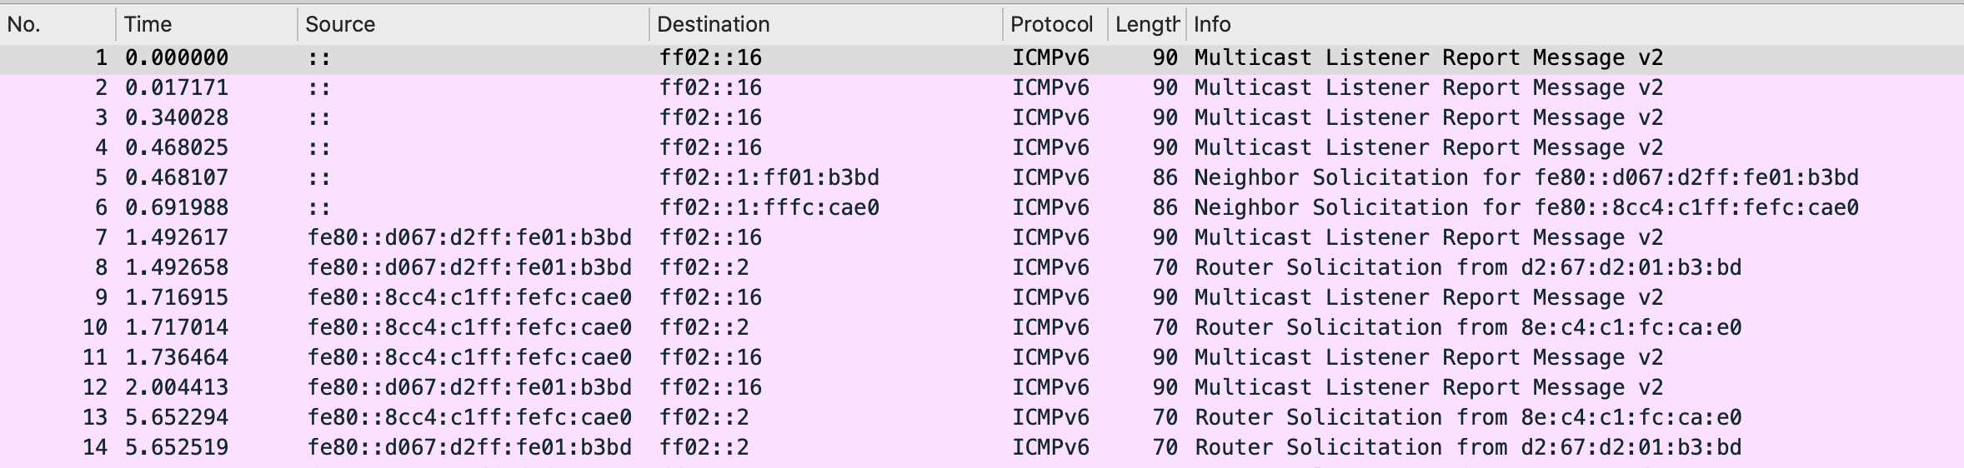
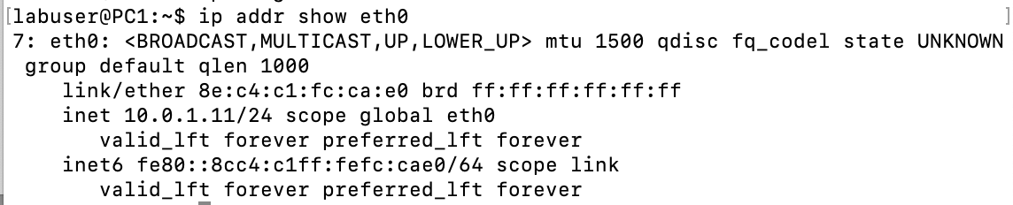
Self Configuration of Host Link-Local
PCs asking for Router
after self configuration

Slide 124
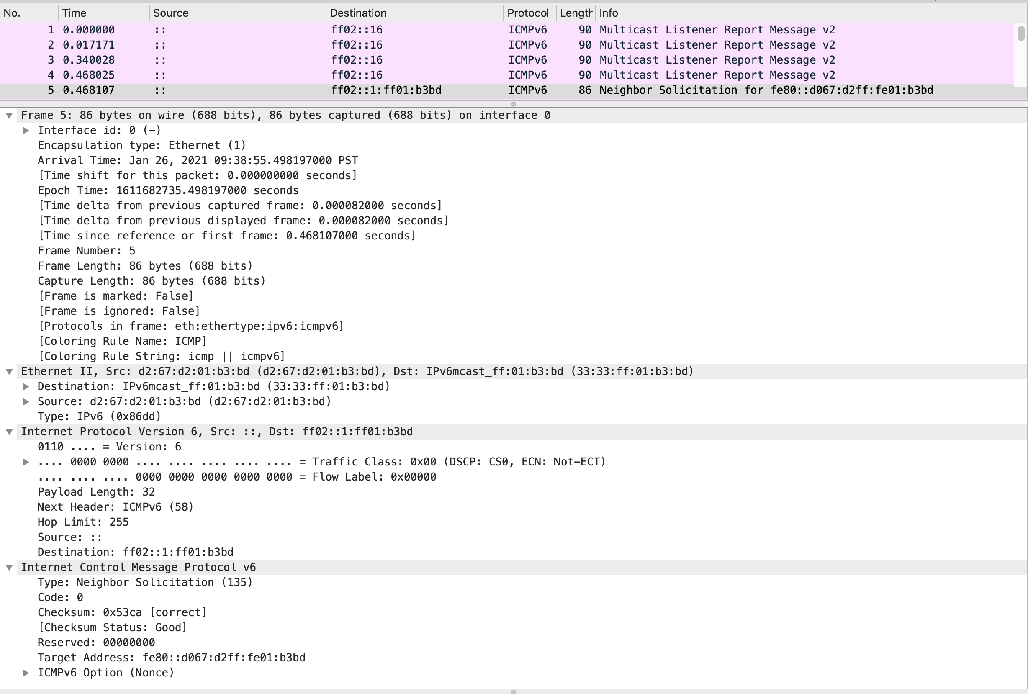
Neighbor Solicitation for Verification sent by Host

Slide 125
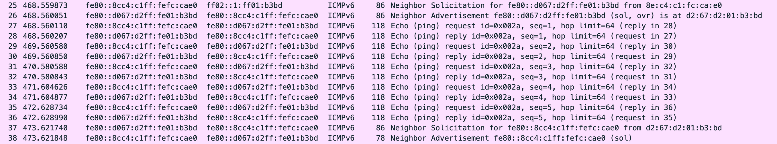
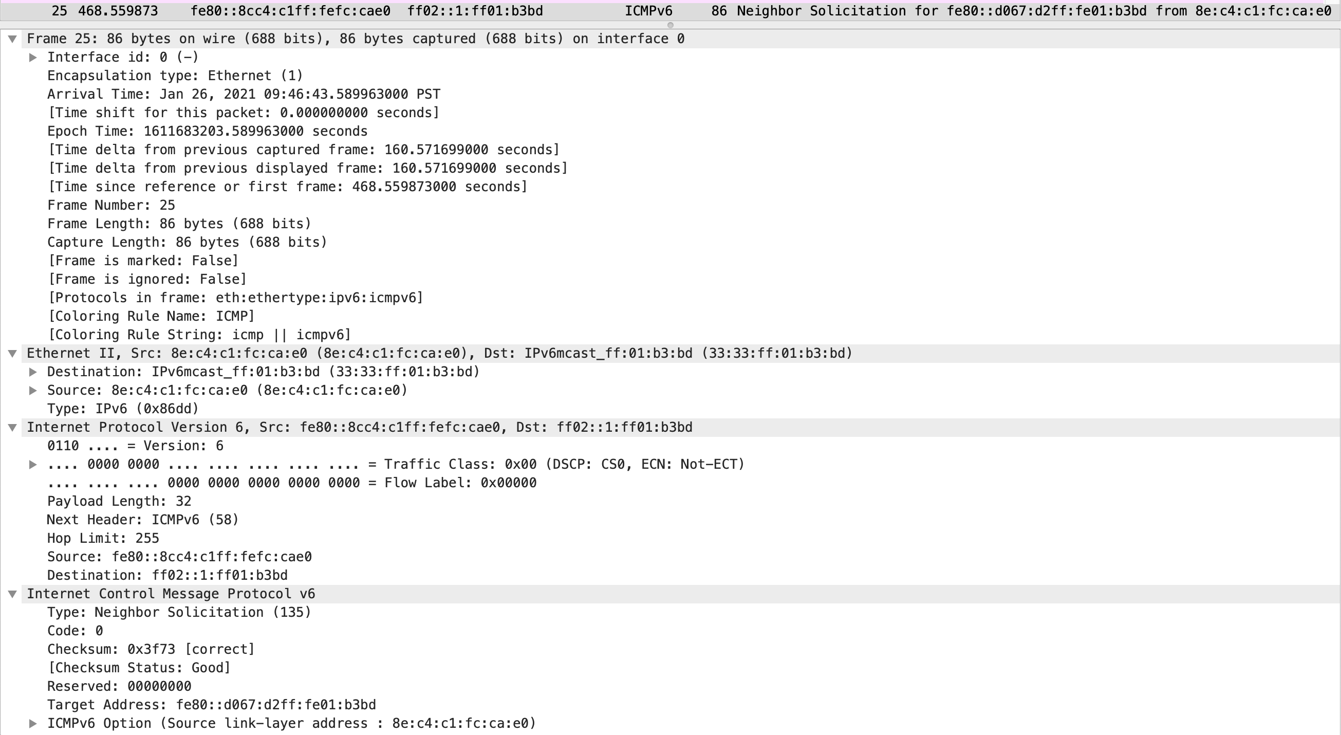
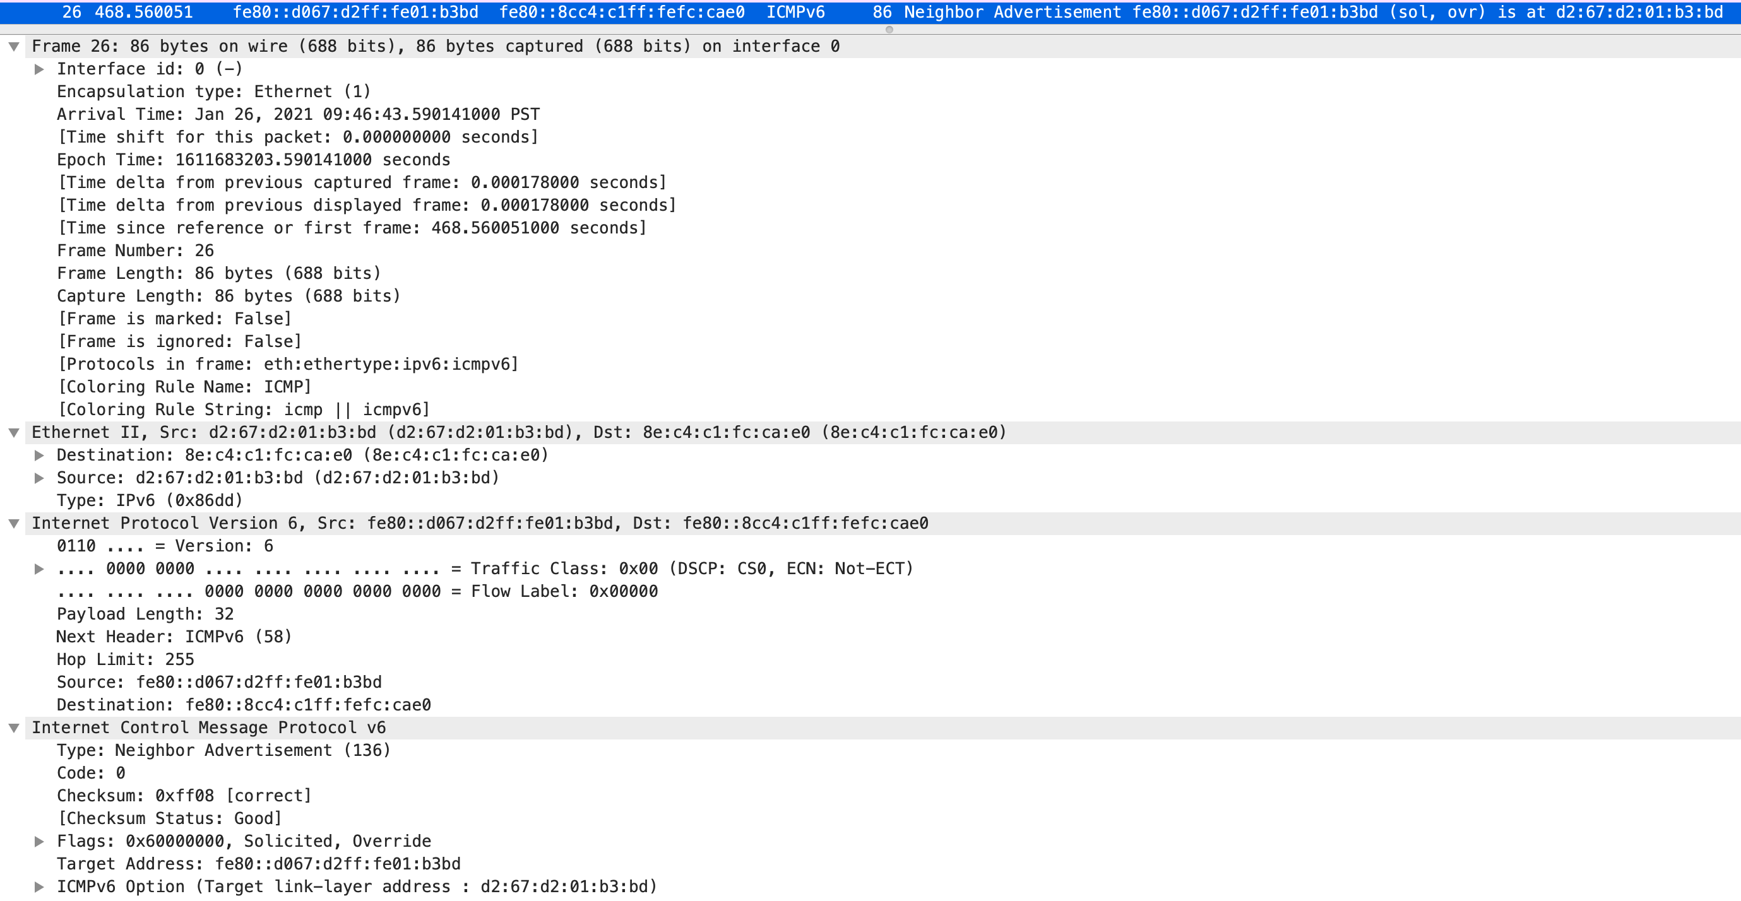
Ping from PC1 to PC2

Slide 126
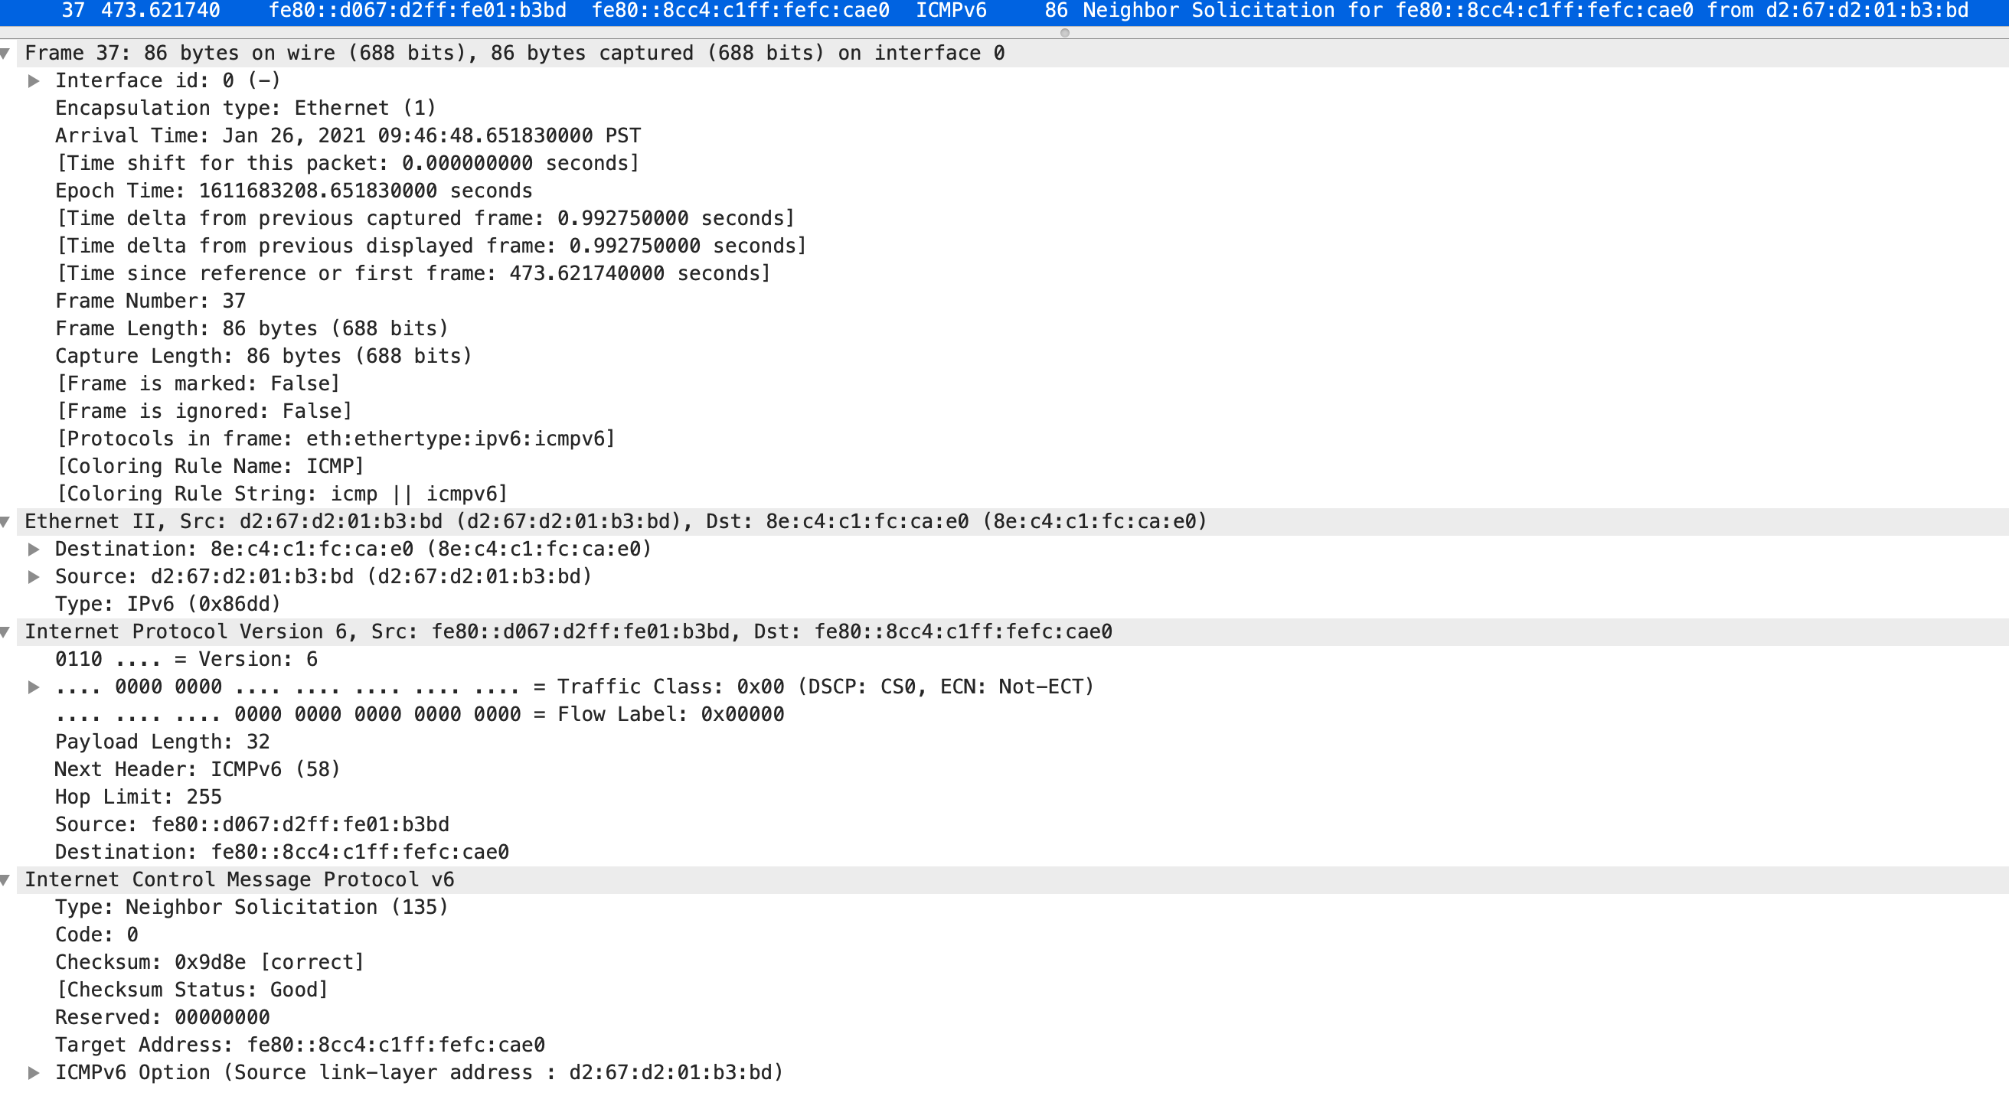
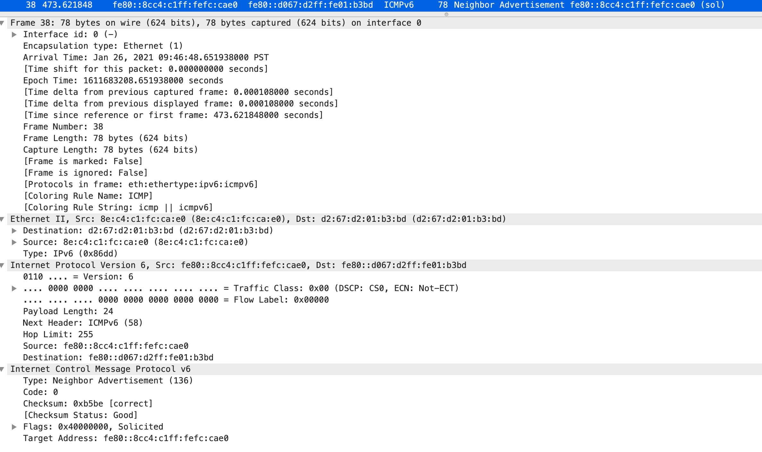
Ping from PC1 to PC2

Slide 127
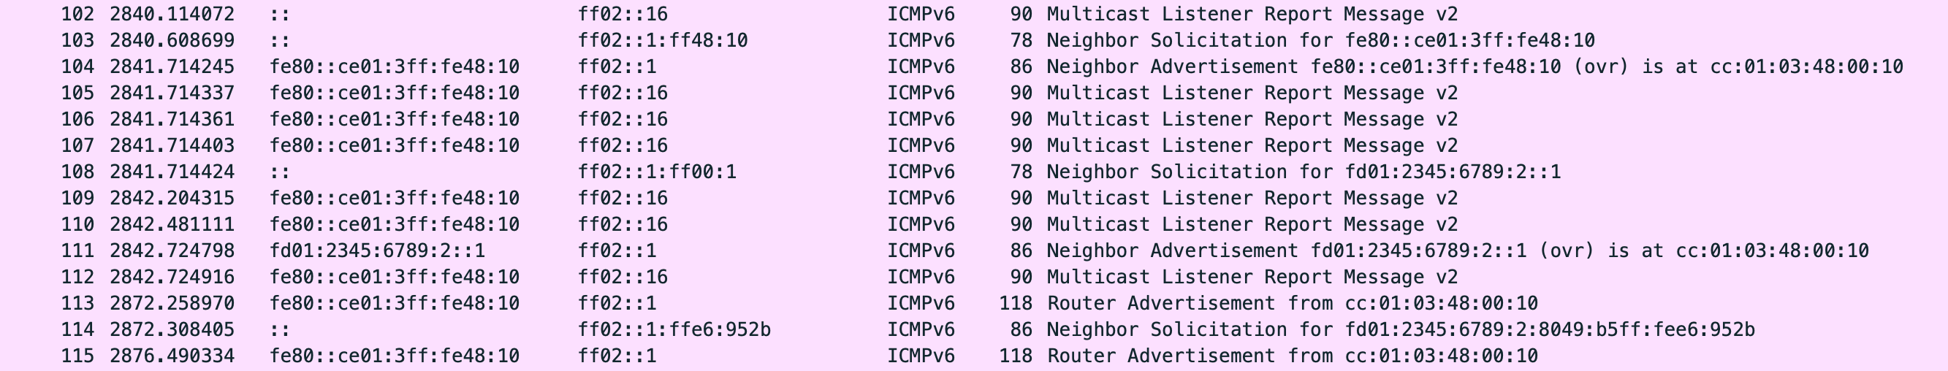
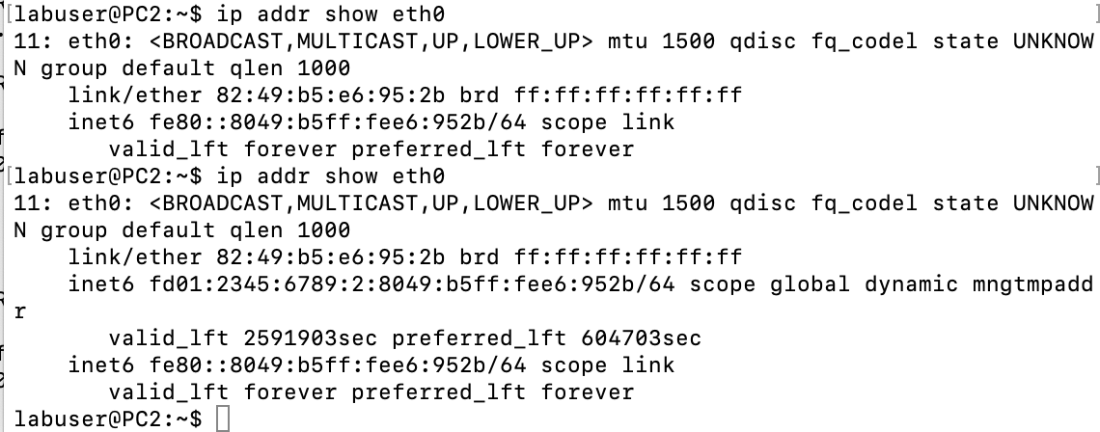
Configuration of router - address verification, Router Adv. Self configuration of local host with unicast address
Router validation its link-local address
Router validation its unicast-local address
Router sends an advertisement and and Host uses the information to create an IPv6 address on the subnet
Host then validates its unicast local IPv6 address

Slide 128
“a second view”
Router checking on
Link-Local Address
Response from itself
Router checking on
Global Address
Response from itself
PC sees Router Advertisement
Uses it to create Global address
Checks if it is unique with solicitation

Slide 129
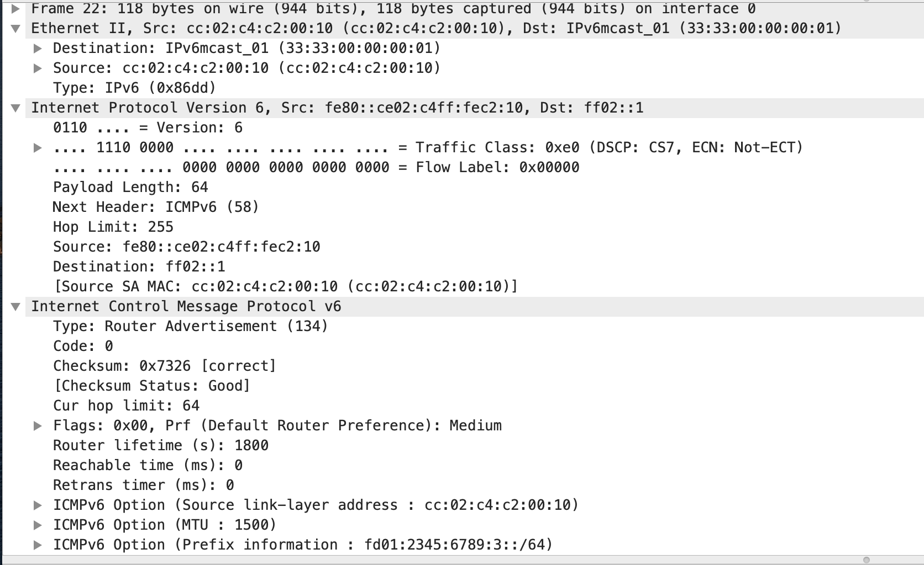
Router Advertisement – Announces Net Prefix

Slide 130
Host IPv6 Self Configuration – Link-Local and global unicast
PC IP address configuration
Link Local (Self) and
Global unicast (Dynamic)
Dynamic: /64 format with MAC
Obtained from Router
Solicitation/Advertisement

Slide 131
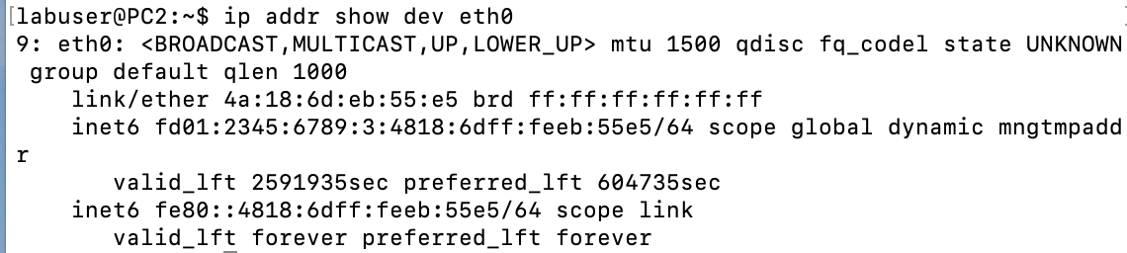
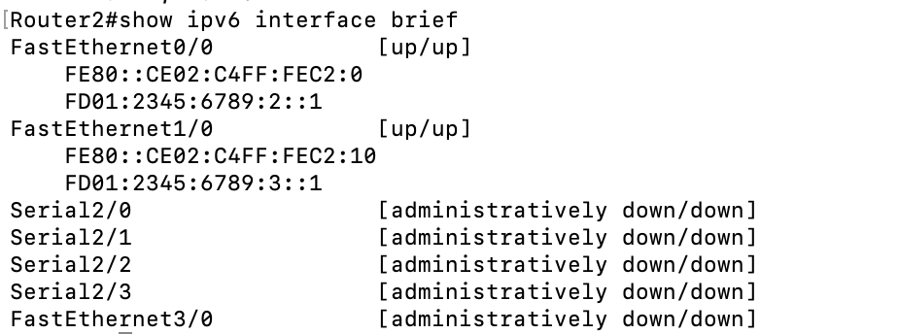
Host IPv6 Self Configuration – Link-Local and global unicast
PC IP address configuration
Link Local (Self) and Global (Dynamic)
Dynamic: /64 format with MAC
Obtained from Router
Solicitation/Advertisement
Router Link-Local and Static IP address configuration

Slide 132
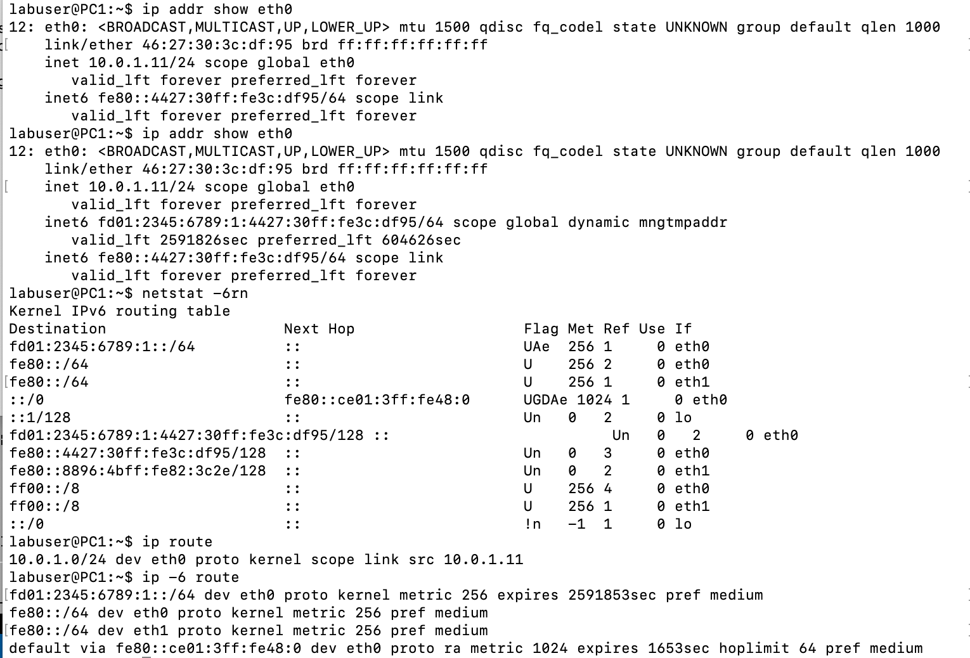
Host Routing Table with Routing Info from Router
The default is via the router link-local

Slide 133
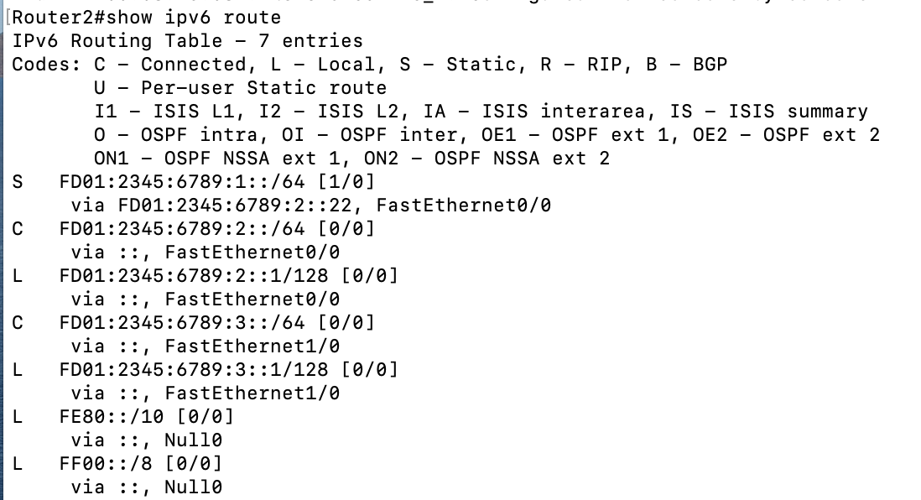
Router Routing Table
Static Entry to remote subnet
Connected Subnets

Slide 134
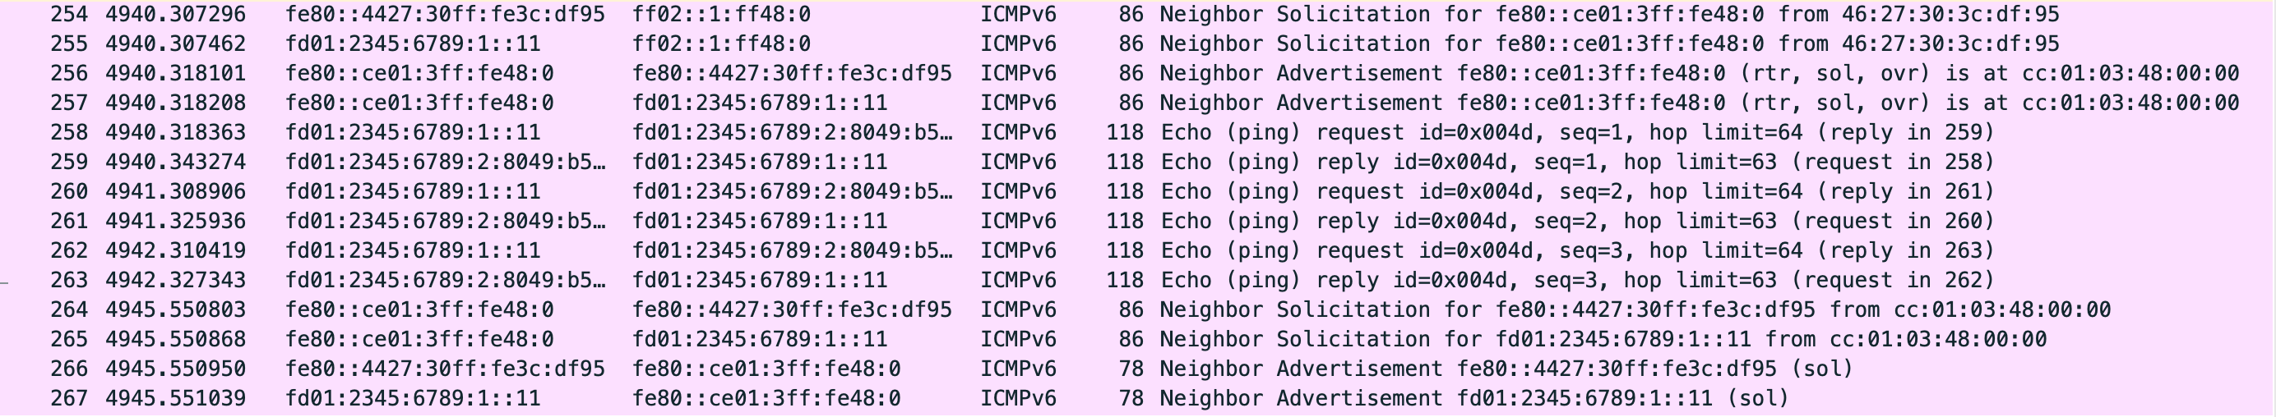
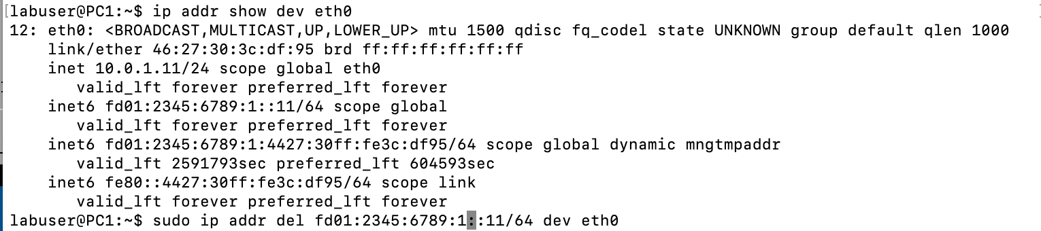
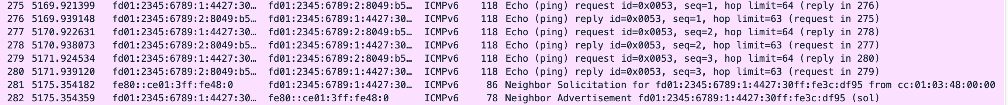
Ping PC1 to PC2 via Router

Slide 135
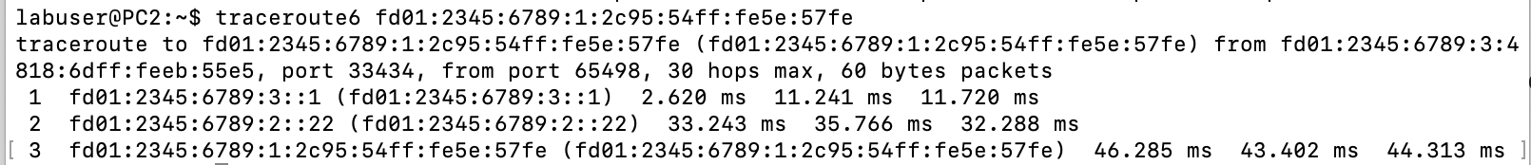
Traceroute output PC2 – PC1 via R1 and R2

Slide 136
Chapter 4: outline
4.1 Overview of Network layer
data plane
control plane
4.2 What’s inside a router
4.3 IP: Internet Protocol (v4)
IP Layer Services and Functions
datagram format
fragmentation
addressing
forwarding
4.4 IPv6
4.5 Internet Control Messaging Protocol (ICMP, ICMPv6)

Slide 137
ICMP: internet control message protocol
a helper protocol for IP
used by hosts & routers to communicate network-level information
error reporting
queries
uses IP for transport
ICMP msgs carried/transported in IP datagrams
enhanced role of ICMPv6 in IPv6:
neighbor discovery
address autoconfiguration
discovering multicast receivers

Slide 138
Overview

Slide 139
Overview
the IP (Internet Protocol) relies on several other protocols to perform necessary error reporting, support of IP configuration, routing functions
many of these functions are provided by ICMP:
 | IPv4 | IPv6
Error signaling | ICMP | ICMPv6
Query information | ICMP | ICMPv6
Support of IP configuration | ICMP (limited) | ICMPv6
Multicast receiver discovery | IGMP | MLD (part of ICMPv6)
Setting up routing tables | RIP, OSPFv2, BGP-4 | RIPng, OSPFv3, BGP-4
Router Solicitation
Router Protocols

Slide 140
Overview
the Internet Control Message Protocol (ICMP) is a helper protocol that supports IP with facility for
error reporting
queries
ICMP messages are encapsulated as IP datagrams:
In IPv4, protocol field in header is set to 1
In IPv6, next header field in header is set to 58

Slide 141
ICMP/ICMPv6 message format
Type: type of ICMP message
Code: subtype of ICMP message
Checksum: similar to IP header checksum. Checksum is calculated over entire ICMP message
Additional information: specific to type and code

Slide 142
ICMP Query message
request sent by host to a router or host
reply sent back to querying host

Slide 143
Example: Echo Request and Reply
“ping” command issues an ICMP Echo Request
receiver responds with an ICMP Echo Reply
Echo Request
Source
ICMP
Host or Router
ICMP
Echo Reply

Slide 144
Format of ICMP Echo Request/Reply
Identifier, Sequence Number: Used by source to match Echo Replies with Echo Requests (Echo Reply does not modify these fields)
Payload (optional): dummy characters

Slide 145
ICMP Error message
ICMP error messages report error conditions
typically sent when a datagram is discarded
error message contains parts of the discarded datagram
error message is passed from ICMP to the higher layers to notify of error

Slide 146
Example: ICMP Network Unreachable
If a routing table lookup does not find a match for the destination IP address, the datagram is discarded and an ICMP Network Unreachable is send to the source of the datagram
IP datagram
Source
Dst: 10.1.0.3
Router
No match in routing table for 10.1.0.3
ICMP
Network Unreachable

Slide 147
Format of ICMP error message
ICMP error messages includes parts of the discarded packet
IPv4: IP header and the first 8 bytes of the payload (typically: UDP, TCP)
IPv6: As much of the discarded packet as possible, but not exceeding minimum MTU
Information on discarded packet is used by source to pinpoint error

Slide 148
ICMP for IPv4

Slide 149
Example of ICMP Queries
Type/Code: Description
8/0 Echo Request
0/0 Echo Reply
13/0 Timestamp Request
14/0 Timestamp Reply
10/0 Router Solicitation
9/0 Router Advertisement
used by the ping command
for synchronization
to find a router on a
subnet

Slide 150
Ping Application and ICMP
PC% ping IPAddr
Host calculates the RTT and displays on screen
Host also keeps statistics on number of transmitted requests and received replies
ICMP Echo Request
ICMP Echo Reply

Slide 151
ICMP Router Solicitation ICMP Router Advertisement
ICMP Internet Router Discovery Protocol (IRDP), also called the Internet Router Discovery Protocol, is a protocol for computer hosts to discover the presence and location of routers on their IPv4 local network.
after starting up, a host broadcasts an ICMP router solicitation (on local subnet only)
in response, routers send an ICMP router advertisement message
also, routers can periodically broadcast ICMP router advertisement
has nothing to do with routing protocols

Slide 152
Common ICMP Error messages
Type | Code | Description
3 | 0–15 | Destination unreachable | Notification that an IP datagram could not be forwarded and was dropped. The code field contains an explanation.
5 | 0–3 | Redirect | Informs about an alternative route for the datagram and should result in a routing table update. The code field explains the reason for the route change.
11 | 0, 1 | Time exceeded | Sent when the TTL field has reached zero (Code 0) or when there is a timeout for the reassembly of segments (Code 1)
12 | 0, 1 | Parameter problem | Sent when the IP header is invalid (Code 0) or when an IP header option is missing (Code 1)

Slide 153
ICMP Error Message: Destination Unreachable
Type | Code | Description
3 | 0–15 | Destination unreachable | Notification that an IP datagram could not be forwarded and was dropped. The code field contains an explanation
Code | Description | Reason for Sending
0 | Network Unreachable | No routing table entry is available for the destination network
1 | Host Unreachable | Destination host should be directly reachable, but does not respond to ARP
2 | Protocol Unreachable | Protocol in the protocol field of the IP header not supported
3 | Port Unreachable | Transport protocol at destination cannot pass datagram to an application
4 | Fragmentation Needed and DF Bit Set | IP datagram must be fragmented, but DF bit in the IP header is set
This error occurs when
a node/device finds a
match for the network
prefix, sends the datagram but no response comes
back.
Arp times out and
response is returned
as Host is not available.
This error occurs when
a node/device cannot
find a match for the
network prefix in its
Forwarding able and it
does not have a default route set up.
In other words, it does not know what to do with the datagram.
It discards it and send this error msg to the source.

Slide 154
Example: ICMP Port Unreachable
RFC 792: If, in the destination host, the IP module cannot deliver the datagram because the indicated protocol module or process port is not active, the destination host may send a destination unreachable message to the source host.
Scenario:
Request a service at a port 80
Client
Server
No process is waiting at port 80
Port Unreachable

Slide 155
Traceroute and ICMP
source host sends series of UDP segments (56bytes) to a destination host
first set (3) has TTL =1
second set (3) has TTL=2, etc.
… and finally unlikely (nonexistent) port number
when datagram in n^{th} set arrives to n^{th} router: TTL=0
router discards datagram and sends to source ICMP message (type 11, code 0) with IP address of incoming port as source address in IP header.
stopping criteria:
UDP segment eventually arrives at destination host
destination returns ICMP “port unreachable” message (type 3, code 3)
source stops
For every received ICMP message, source records RTTs
3 probes
3 probes
3 probes

Slide 156
Example of Traceroute output
traceroute: gaia.cs.umass.edu to www.eurecom.fr
3 delay measurements from
gaia.cs.umass.edu to cs-gw.cs.umass.edu
1 cs-gw (128.119.240.254) 1 ms 1 ms 2 ms
2 border1-rt-fa5-1-0.gw.umass.edu (128.119.3.145) 1 ms 1 ms 2 ms
3 cht-vbns.gw.umass.edu (128.119.3.130) 6 ms 5 ms 5 ms
4 jn1-at1-0-0-19.wor.vbns.net (204.147.132.129) 16 ms 11 ms 13 ms
5 jn1-so7-0-0-0.wae.vbns.net (204.147.136.136) 21 ms 18 ms 18 ms
6 abilene-vbns.abilene.ucaid.edu (198.32.11.9) 22 ms 18 ms 22 ms
7 nycm-wash.abilene.ucaid.edu (198.32.8.46) 22 ms 22 ms 22 ms
8 62.40.103.253 (62.40.103.253) 104 ms 109 ms 106 ms
9 de2-1.de1.de.geant.net (62.40.96.129) 109 ms 102 ms 104 ms
10 de.fr1.fr.geant.net (62.40.96.50) 113 ms 121 ms 114 ms
11 renater-gw.fr1.fr.geant.net (62.40.103.54) 112 ms 114 ms 112 ms
12 nio-n2.cssi.renater.fr (193.51.206.13) 111 ms 114 ms 116 ms
13 nice.cssi.renater.fr (195.220.98.102) 123 ms 125 ms 124 ms
14 r3t2-nice.cssi.renater.fr (195.220.98.110) 126 ms 126 ms 124 ms
15 eurecom-valbonne.r3t2.ft.net (193.48.50.54) 135 ms 128 ms 133 ms
16 194.214.211.25 (194.214.211.25) 126 ms 128 ms 126 ms
17 * * *
18 * * *
19 fantasia.eurecom.fr (193.55.113.142) 132 ms 128 ms 136 ms
trans-oceanic
link
* means no response (probe lost, router not replying)
Notes:
The source host will send out another ICMP request with higher TTL, it tries that several times till it gets a response or a destination unreachable error. If TTL exceeds max, it stops and ends the quest.

Slide 157
Parameters for Traceroute
traceroute -w 3 -q 1 -m 16 example.com
-w wait time in secs between probes, here shown as 3
-q no. of probes sent out for each set, here shown as 1
-m max. no. of hops (TTL value) to try to reach destination. Default is 30, here given as 16

Slide 158
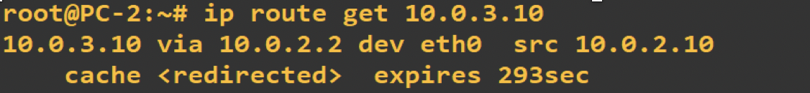
Routing Error: table manipulations with ICMP
when a router detects that an IP datagram should have gone to a different router, the router (here R2)
forwards the IP datagram to the correct router
sends an ICMP redirect message to the host
host uses ICMP message to update its forwarding cache not its forwarding table!!!
Note a network redirect
Is when destination host
on network 10.1.0.0/24 and R1
is next hop to 10.1.0.0/24
A host redirect is when
10.1.0.0/24 is an interface of R1
R1
Routing Cache

Slide 159
ICMPv6

Slide 160
ICMPv6
in IPv6, ICMP plays a bigger role
some IPv4-related protocols are consolidated under ICMP (ARP, IGMP)
combinations of ICMPv6 messages realize “subprotocols”
Neighbor Discovery Protocol (NDP)
Neighbor Solicitation/Advertisement
Router Solicitation/Advertisement Redirect Message
Multicast Listener Discovery (MLD) Protocol
Multicast Listener Query Multicast Listener Report Multicast Listener Done
MTU Discovery Protocol
Packet Too Big
Secure Neighbor Discovery (SEND) Protocol
Certification Path Solicitation Certification Path Advertisement
Multicast Router Discovery (MRD) Protocol Multicast Router Advertisement
Multicast Router Solicitation
Multicast Router Termination

Slide 161
ICMPv6
Many queries and error messages found in ICMPv6 are similar to those in ICMP for IPv4
Echo Request/Reply
Destination unreachable
…

Slide 162
Path MTU Discovery
Recall: Intermediate IPv6 routers never perform fragmentation
Path MTU = max. datagram size used by a source to a given destination
path MTU ≤ min. MTU on any link between source and destination
Router issues an ICMP Packet Too Big (Type =2) if a datagram exceeds the MTU of the outgoing link
Path MTU Discovery Protocol
initially: Set Path MTU to the MTU at the source (on the outgoing link)
whenever the source receives an ICMP Packet Too Big, the source reduces the Path MTU
this continues until no error message arrives

Slide 163
Stateless Autoconfiguration
Refers to the automatic generation of a global unicast addresses
IPv6 address is configured without a server (→stateless)
Uses ICMPv6 messages
Router Advertisement
Router Solicitation

Slide 164
ICMP Router Solicitation/Advertisement
ICMP Router Solicitation is sent to the “all routers” multicast group
ICMP Router Advertisement sent to “all nodes” multicast group
Router Advertisement contains:
Network prefix
MTU
Default Hop limit
Router Advertisement may tell host to use DHCP

Slide 165
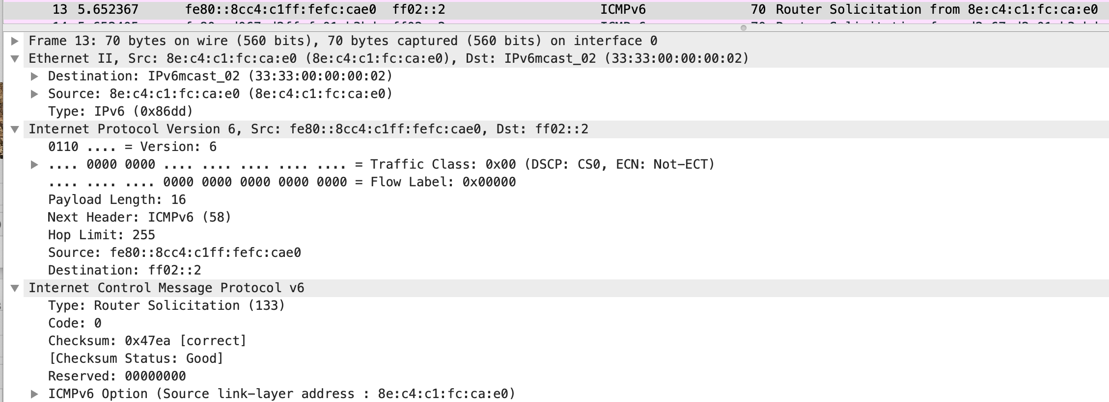
Router Solicitation

Slide 166
Router Advertisement – Announces Net Prefix

Slide 167
Stateless Autoconfiguration
Refers to the automatic generation of a global unicast addresses
IPv6 address is configured without a server (→stateless)
Uses ICMPv6 messages
Router Advertisement
Router Solicitation

Slide 168
Stateless Address Autoconfiguration
Stateless address autoconfiguration can set IP parameters of a host without a server or manual configuration:
Upon startup, host creates link-local addresses for each IPv6 interface from MAC address
Test uniqueness by sending an ICMP Neighbor Solicitation to the created address
If a host replies with Neighbor Advertisement, address is in use
If no response, address (and interface ID) can be used
Hosts sends ICMP Router Solicitation to “all routers” group
Router replies with ICMP Router Advertisement
Host creates a globally routable IP address using the prefix sent by the router and the Interface ID from the link-local address. Also, the advertising router becomes default gateway of host

